Slide 1

The Kubernetes platform
for big ideas

Slide 2
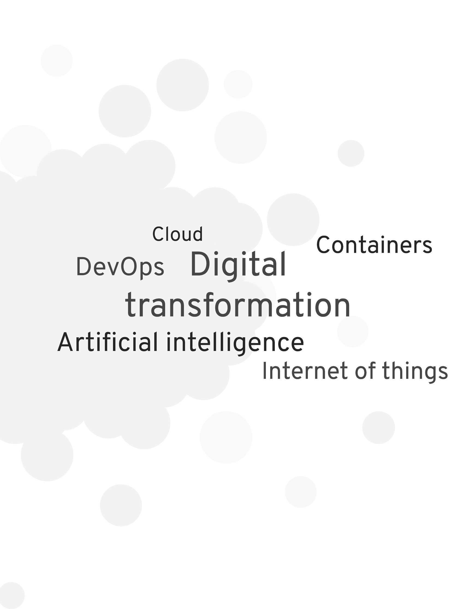

Big ideas drive business innovation
Business innovation is all around us.
Every organization in every geography and in every industry can innovate and create more customer value and differentiation with open source technologies and an open culture.
Open source communities
Open organization
Kubernetes
Notes:
Intro - Business innovation is driven by big idea:
Wow - what an incredible time we live in. What an exciting time to be alive!
Business is moving faster than ever before. Today, we can do things we could only dream of a few years ago.
Technology, open source communities and new ways of collaboration are driving business innovation
No longer are we looking at startups and Web 2.0 companies like Facebook, Uber and Airbnb for inspiration as to what innovation looks like.
Today, every organization in every geography and any industry can innovate, create more customer value and differentiation and compete on an equal playing field.
And with Red Hat OpenShift, we’re building on our heritage of Red Hat Enterprise Linux to provide you with a platform that enables your organization to innovate faster.
But why is being able to move faster and innovate so important?

Slide 3





Creating value depends on your ability to deliver applications faster
Cloud-native applications
AI & machine learning
Analytics
Internet of Things
Innovation culture
Containers, Kubernetes, and hybrid cloud are key ingredients.
OpenShift is the best platform to deliver container-based applications.
Notes:
What we hear from customers around the world is that their ability to create value for their end customers, both internal and external, depends on your ability to deliver applications faster.
It’s really your ability to be great at application development and app delivery to differentiate your business, engage customers, and find new ways to create value that could turn into revenue opportunities.
For example, the CEO of Volkswagen says that there are now more than 10 Million lines of code going into the average car, probably more than what’s in your smart phone.
Best Buy uses a combination of customer-facing mobile apps, brick-and-mortar and services strategies to thrive in the face of Amazon.
And even GE Digital has adopted what they call Kubernetes-as-a-service to enable developers to innovate across their organization.
Containers and Kubernetes fundamentally enable DevOps, microservices and cloud-native application development, and we’d like to think that OpenShift is the best platform to deliver applications across the hybrid cloud.

Slide 4

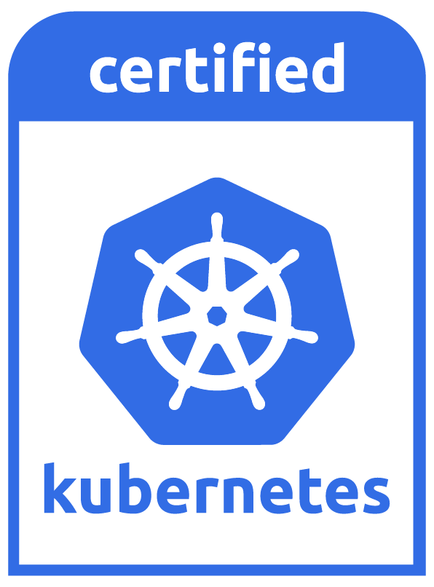
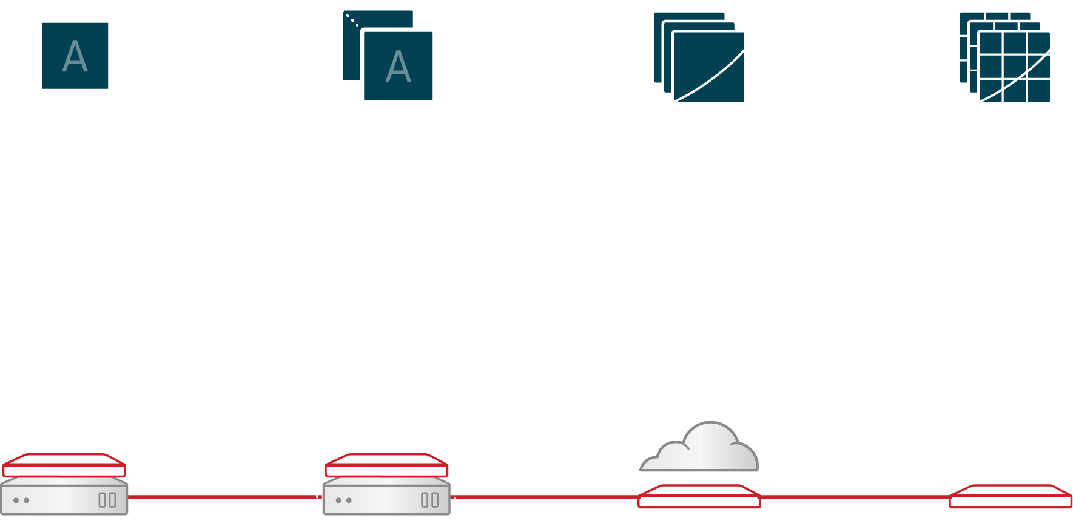
With OpenShift you can deliver all your applications in a whole new way
Traditional apps
Cloud-native apps
AI/ML, Functions...
Container & DevOps Platform
Edge
Datacenter
Hybrid & Multi-Cloud
Notes:
Creating value for both external and internal customers depends on your ability to deliver applications faster.
We believe that containers, Kubernetes and Devops are the key ingredients that a modern application platform should be based on that allows you to transform your traditional apps, build cloud-native applications and also experiment with analytics, machine learning and serverless applications.
This application platform needs to provide a consistent way for both developers and operations teams to collaborate across all deployment footprints, from Edge and air gapped environments to infrastructure you have in your own datacenter and all the way to the hybrid cloud.

Slide 5

“”
We got the idea to have all these tests we do with hardware on virtual test environments, and that’s why we’ve come to OpenShift and containers.
Michael Denecke
Head of Test Technology
Volkswagen AG
VOLKSWAGEN
Autonomous Vehicle Testing
Notes:
https://blog.openshift.com/how-volkswagen-tests-autonomous-cars-with-gpus-and-openshift/
Autonomous driving and connected cars are on the forefront of their thinking
The traditional way of integration testing of the hardware for the cars was inefficient and time consuming
OpenShift is allowing them to spawn virtual test environments for their hardware
The time savings for them was immeasurable
Literally, anything they dream up -- they can easily simulate virtually now
This results in significant cost savings for both OPEX and CAPEX

Slide 6
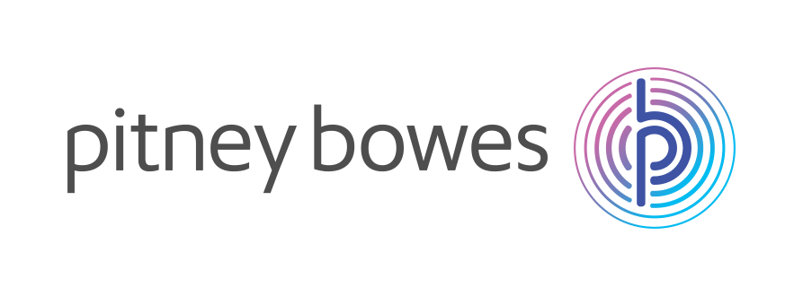







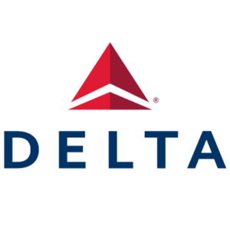


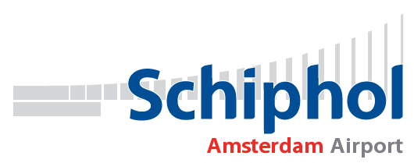









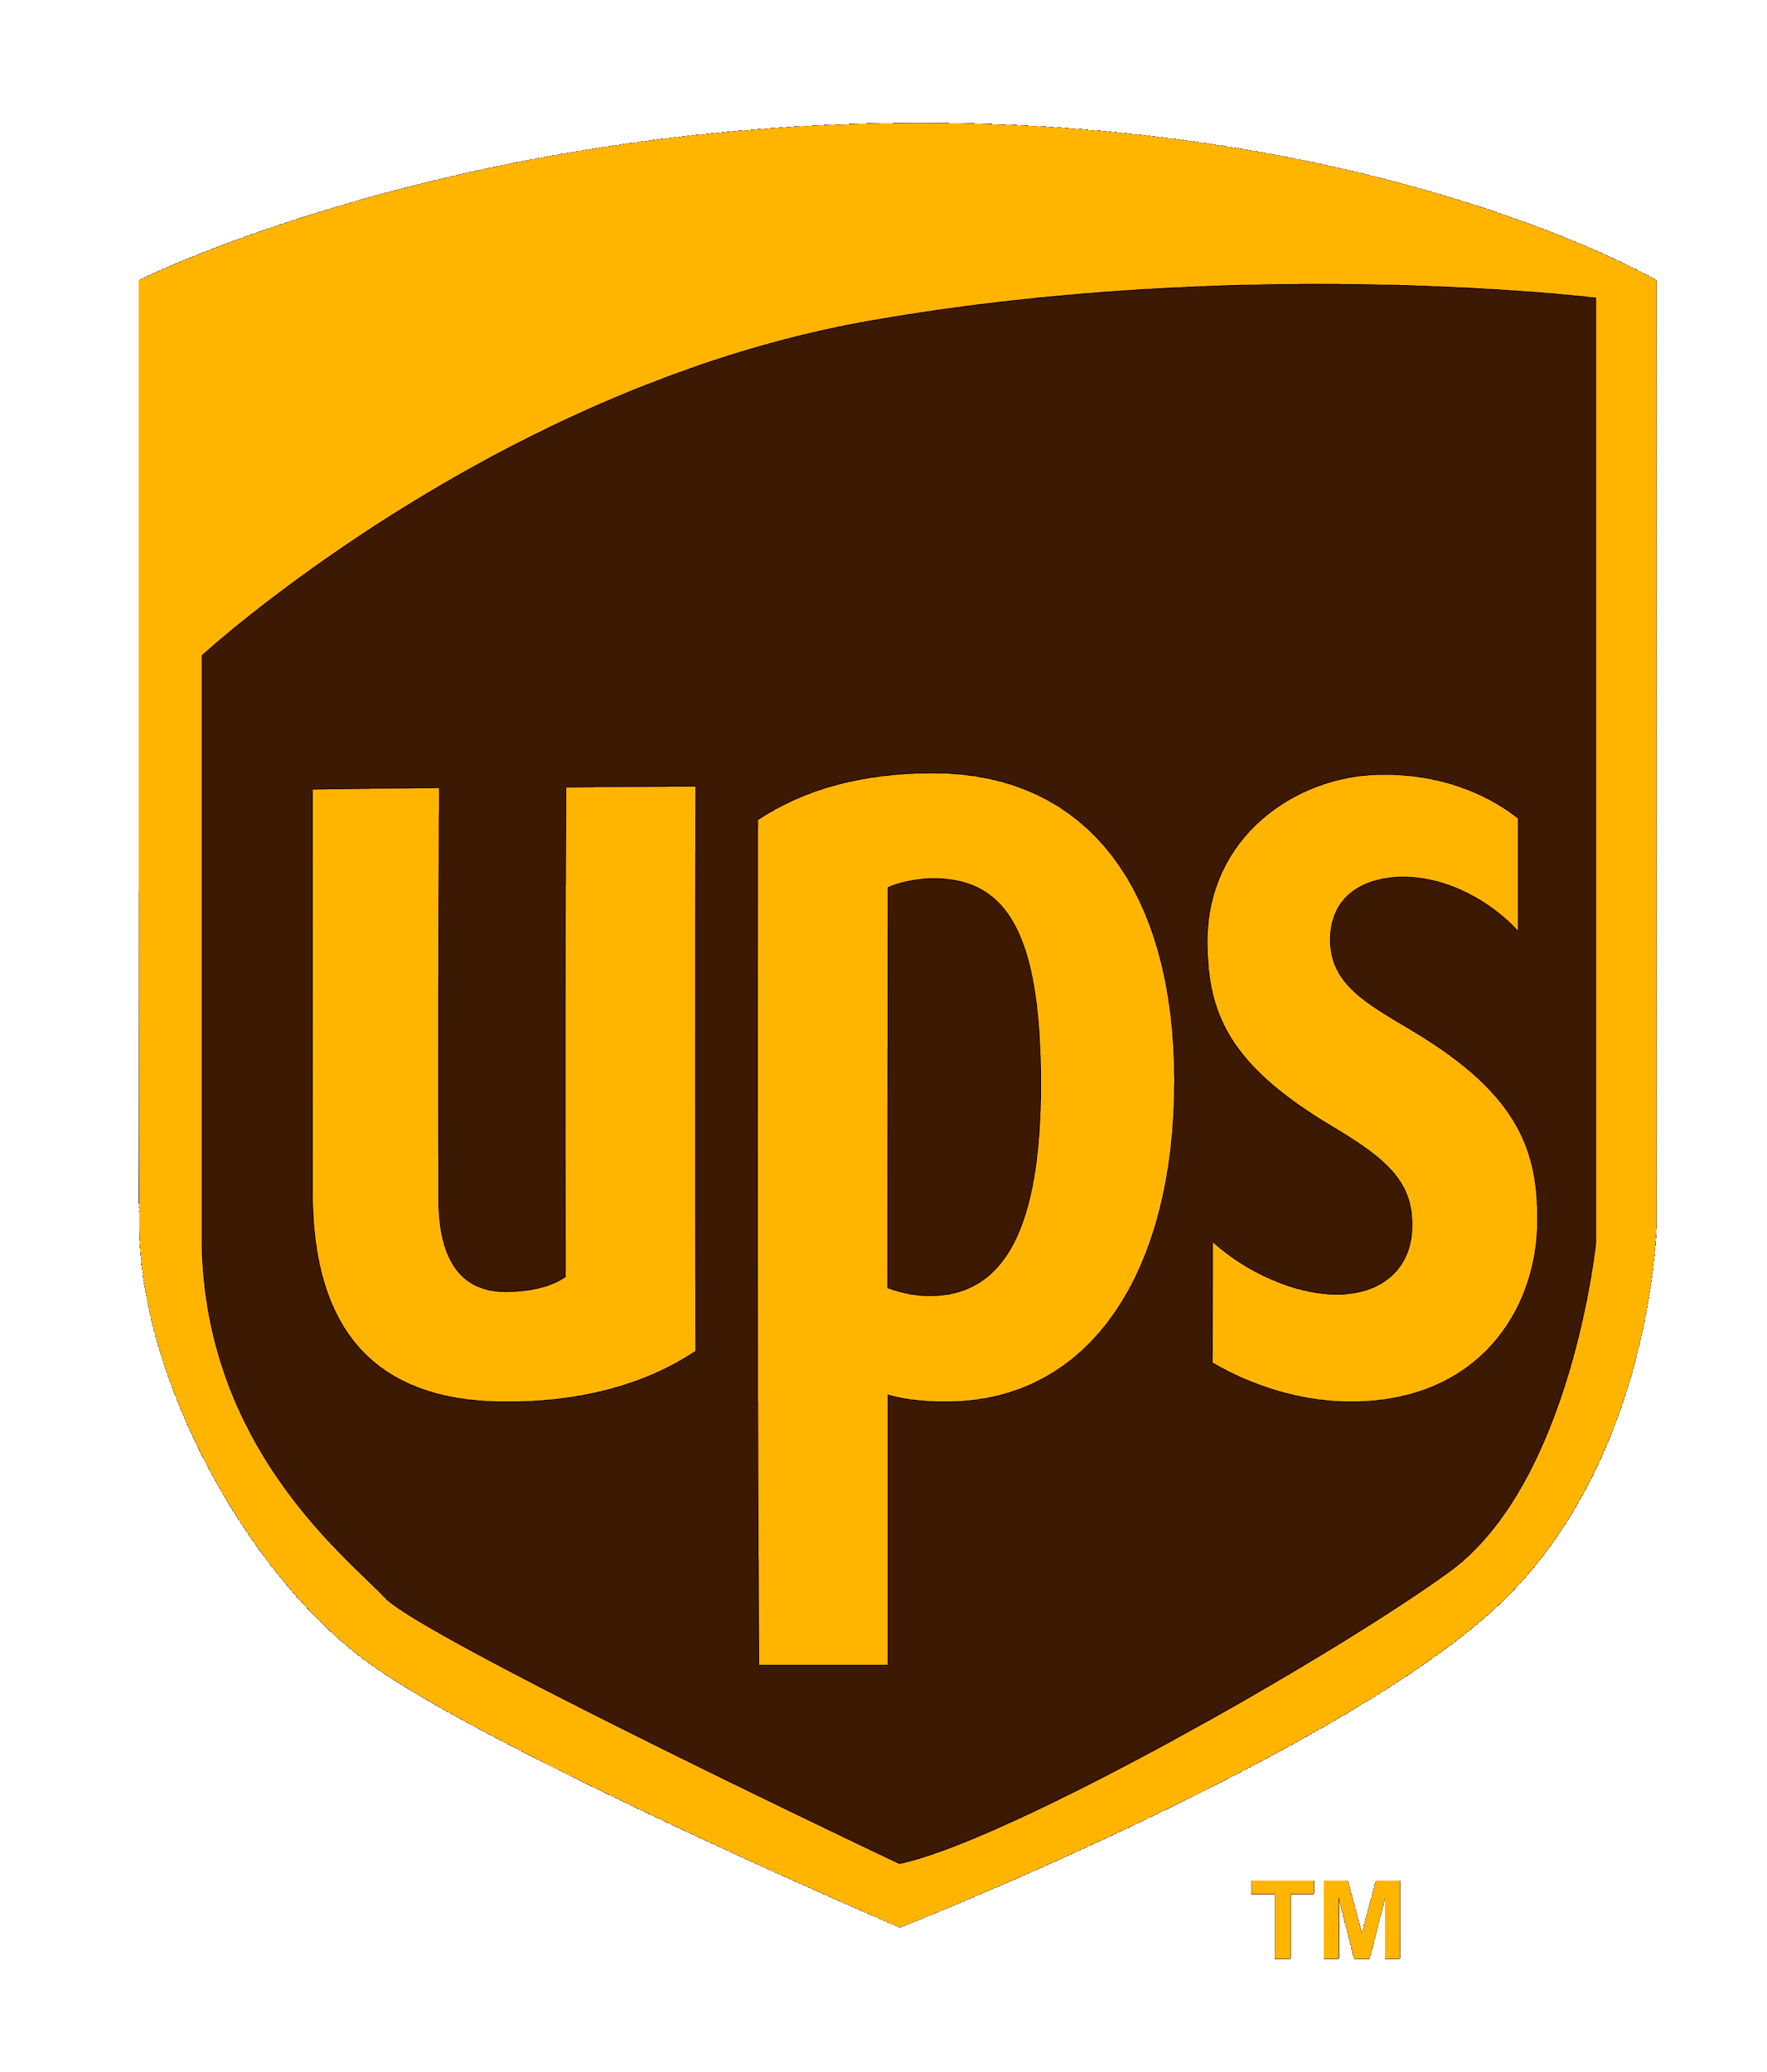




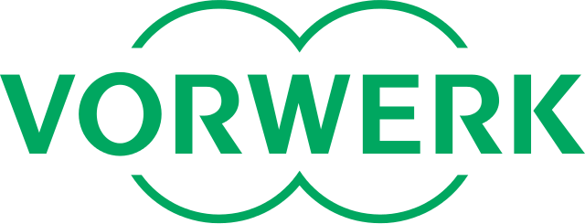

More than 1,000 OpenShift customers
MODERNIZE APPS
WEB APPS
CLOUD NATIVE DEV
MULTI-CLOUD
MOBILE
BIG DATA | ANALYTICS
AI | ML
IOT
Notes:
As we look at how our customers round the globe are using OpenShift, we find solutions that span a broad range of use cases. As you glance through this slide, you see that very notable companies are using OpenShift to solve a variety of their digital transformation needs. From efforts in modernizing their legacy applications through creating Internet-of-Things solutions, these organizations are leveraging OpenShift to deploy containerized solutions that are transforming the way they do business. Companies like HCA are fighting Sepsis in their hospitals to reduce the number of preventable deaths from the condition. Emirates NBD is changing the face of mobile banking for their customers. And Cathay Pacific is improving their customer experience by migrating legacy applications into a more agile, containerized model.

Slide 7
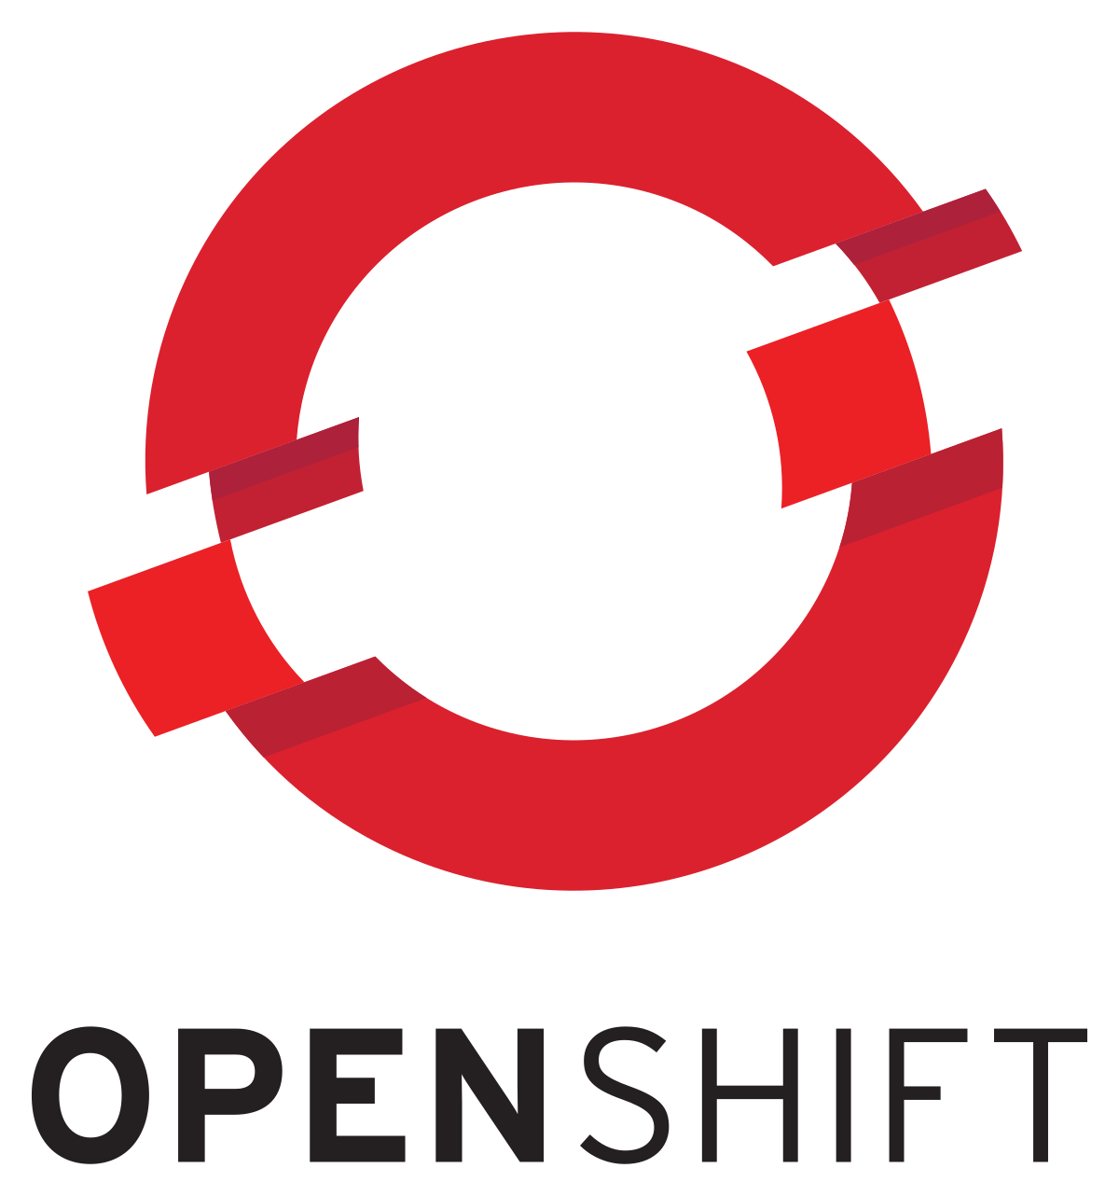


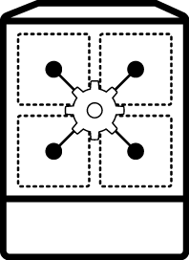

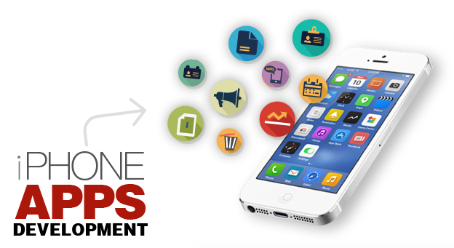
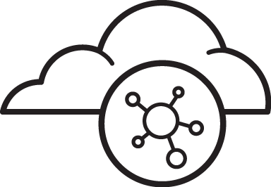

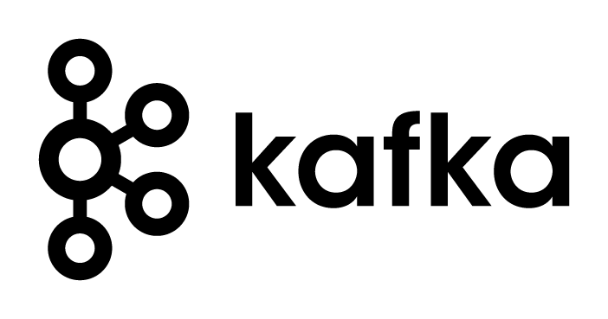
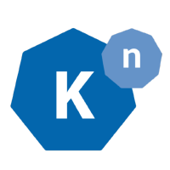
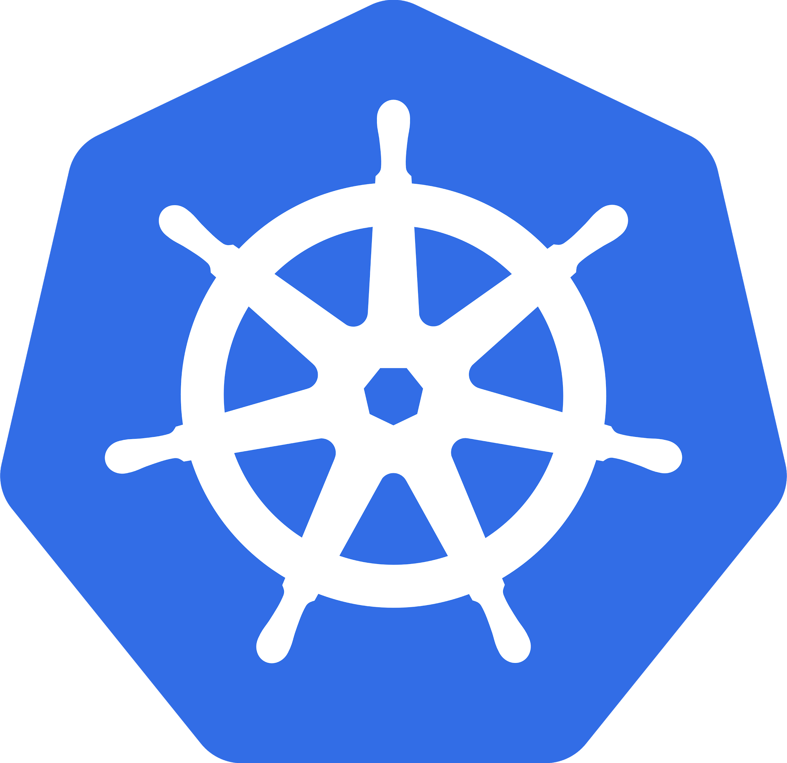



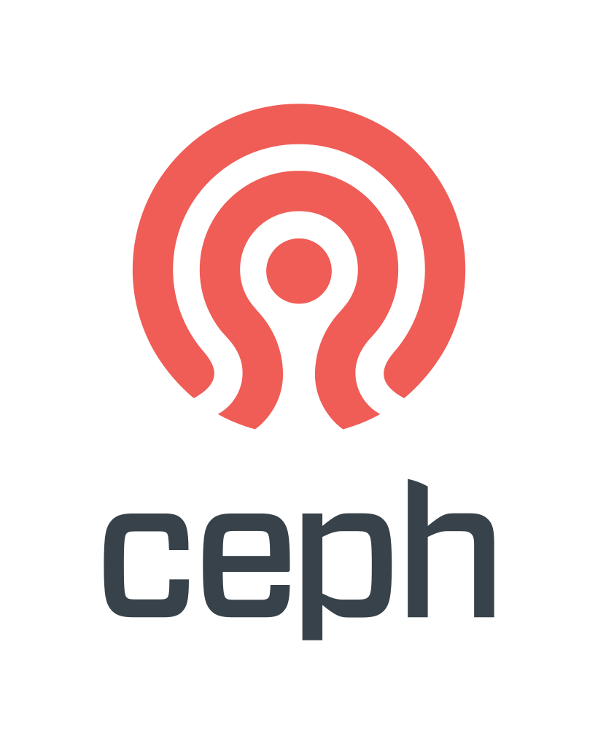
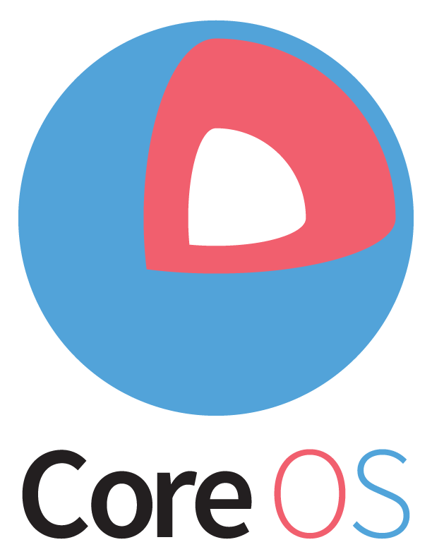

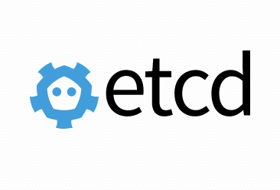
Why customers choose Red Hat OpenShift
Trusted enterprise Kubernetes
Cloud-like experience everywhere
Empowering developers to innovate
Open source innovation
Notes:
The guiding principles behind OpenShift can be categorized into four areas:
Innovation is happening in Open Source communities, and Red Hat is the best positioned company to help contribute and grow those community, as well as bring the value of that innovation to customers.
While customers have demands to run applications in many clouds, they also want to reduce the amount of operational complexity that comes from multi-cloud strategy. OpenShift enables customers to have a consistent development and operational experience across any combination of clouds (public and private).
As we’ve learned over the years, there is no single profile of a developer or the way that developers want to get applications into production. So OpenShift is flexible to enable many ways to empower developers and allow many types of applications on the platform.

Slide 8
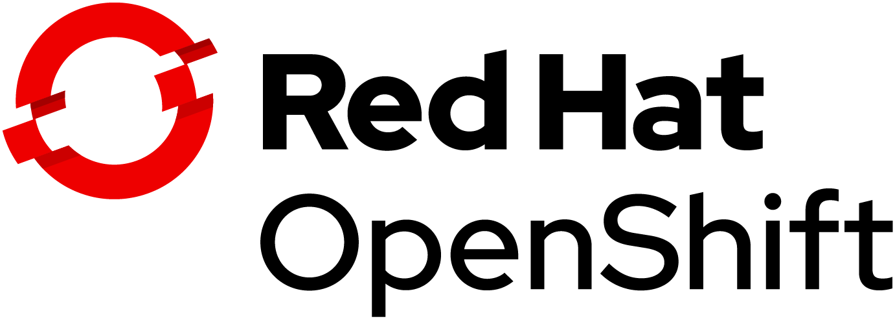
CONTAINER CHALLENGES
Container security
Image scanning, patching, and compliance
Trusted enterprise Kubernetes
Continuous security, world-class support and services, and deep expertise to confidently run any application
Day 2 management
Installations, upgrades, and maintenance Integration of existing enterprise technology
A cloud-like experience, everywhere
Full-stack automated operations on a consistent foundation across on-premises or hybrid cloud infrastructure
Application delivery
Monitoring, metering, and management Integration of existing developer tools
Empowerment for developers to innovate
Ability to get applications to production sooner with a wide range of technologies and streamlined workflows
Notes:
Here is how we address container adoption challenges in OpenShift, and what is the value that OpenShift provides in each of these categories.
We take container security very seriously and take a holistic approach to deliver what we call a trusted enterprise Kubernetes platform. As you know, containers are Linux, and so is Kubernetes. And because we also provide RHEL which is trusted by 1,000s of Enterprises worldwide we can deliver a secure platform across the stack and stand behind it with long-term support.
We recognize that keeping up with the frequent upstream releases can be challenging and we’re investing in automated capabilities like the operator framework and over-the-air updates to make it easier to keep up to date with the latest innovations coming out of the communities and to deploy containers at scale.
It’s all about the developers and we’re investing in (1) automation capabilities in OpenShift, e.g CICD pipelines, AB testing etc, (2) developer tools like Codeready Workspaces and (3) cloud-native frameworks including Spring, serverless and Windows containers to inspire developers to create the best code. No matter what applications you’re building, chances are you can improve developer productivity with OpenShift.

Slide 9

Trusted enterprise Kubernetes
Trusted host, content, platform
Full-stack automated installation
Seamless updates
Notes:
We’ve structured our OpenShift 4 enhancements along the three main customers why customers choose OpenShift. In this section we’ll show you how OpenShift is becoming an even better enterprise Kubernetes platform.

Slide 10

Kubernetes done right is hard
INSTALL
DEPLOY
HARDEN
OPERATE
● Templating
● Validation
● OS setup
● Identity & security access
● App monitoring & alerts
● Storage & persistence
● Egress, ingress, & integration
● Host container images
● Build/Deploy methodology
● Platform monitoring & alerts
● Metering & chargeback
● Platform security hardening ● Image hardening
● Security certifications ● Network policy ● Disaster recovery
● Resource segmentation
● OS upgrade & patch
● Platform upgrade & patch ● Image upgrade & patch
● App upgrade & patch ● Security patches ● Continuous security scanning
● Multi-environment rollout
● Enterprise container registry
● Cluster & app elasticity
● Monitor, alert, remediate ● Log aggregation
75%
of enterprise users identify complexity of implementation and operations as the top blocker to adoption
Source: The New Stack. The State of the Kubernetes Ecosystem, August 2017.
Notes:
Slide takeaway: Installing Kubernetes and playing around with it for many is not a big issue, but establishing Kubernetes as the platform for the enterprise to run business critical applications takes a lot more.
While it actually is not that hard to download and install Kubernetes, getting it really ready for production to run business critical applications for an enterprise takes a lot lot more. There are a number of things that need to be pieced together, tested and hardened for operations.
For example, just take identity management. With Kubernetes, you will be providing access to critical internal systems to employees, partners, and customers. You need to adhere to the security rules established in the company, the way to do that is to write an integration between Kubernetes and your company’s approved LDAP. That requires knowledge of Dex, the open source identity system, Kubernetes and integration systems to LDAP. Similarly, you’ll need to hook up Prometheus, open source monitoring and alerting or hook up another monitoring system so you can get full visibility into your Kubernetes operations in testing and production.

Slide 11

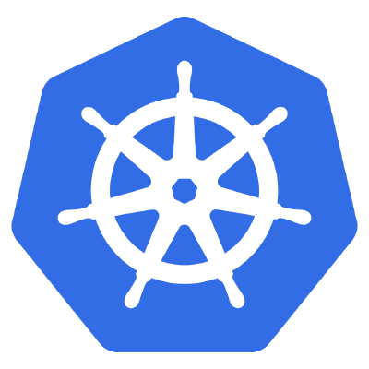

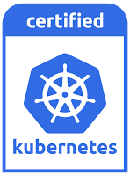
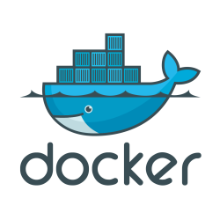

OpenShift is trusted enterprise Kubernetes
Kubernetes release
Production Ready
OpenShift release
...
Hundreds of defect and performance fixes
200+ validated integrations
Certified container ecosystem
9-year enterprise life-cycle management
Red Hat is a leading Kubernetes contributor since day 1
Notes:
Let’s explain how we build OpenShift. At Red Hat we use a 100% open source development model to deliver enterprise products. No fork, no rebase, no proprietary extensions.
Our secret source is our ability to turn dozens and hundreds of open source projects into production ready, stable and secure enterprise products that we support over many years.
When the community declares a release ready, we typically find hundreds of defects that we fix in the corresponding downstream releases.
We can do that because we have been contributing to Kubernetes and many other projects that OpenShift is based on since day 1.
Red Hat is the largest enterprise developer of Kubernetes besides the project sponsor which is Google.

Slide 12
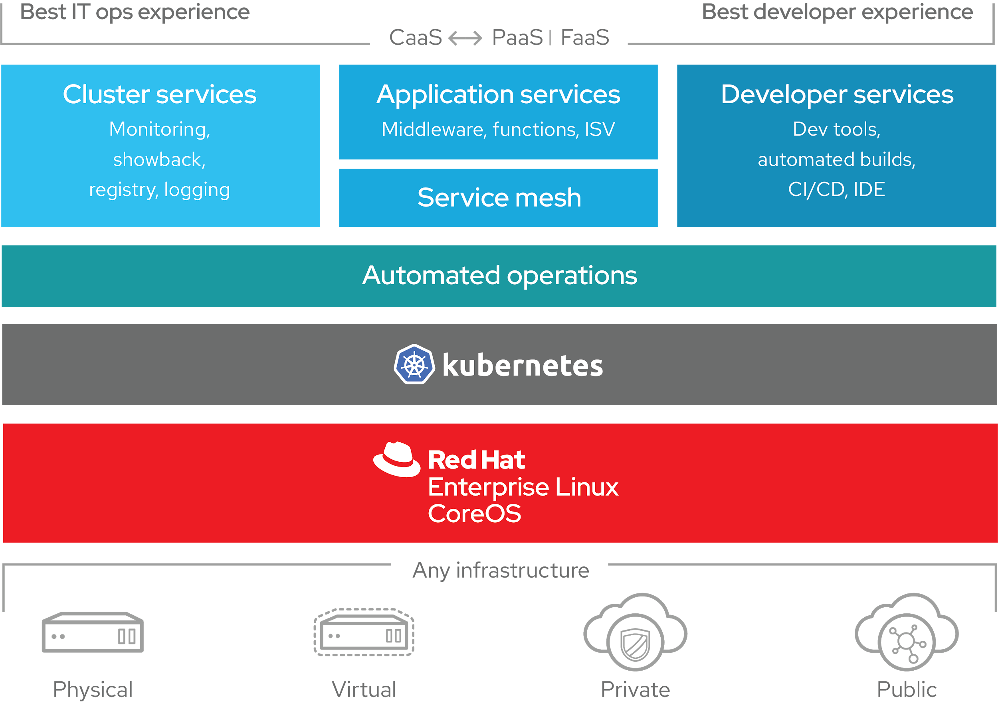
OpenShift 4 - A smarter Kubernetes platform
Automated, full-stack installation from the container host to application services
Seamless Kubernetes deployment to any cloud or on-premises environment
Autoscaling of cloud resources
One-click updates for platform, services, and applications
Notes:
With this foundation of a trusted, enterprise Kubernetes platform, we add productive enhancements to deliver an application platform with all the components you need that are fully integrated to build, deploy and manage containerized applications.
In many ways, OpenShift 4 is a smarter Kubernetes platform because we’ve streamlined the installation and upgrade experience.
You can be up and running with a fully configured Kubernetes cluster in less than 15 minutes. And you have everything you need, from metering and monitoring at the cluster level, application and developer services.
Kubernetes updates, security patches and component updates can be deployed with a single click.
Based on RHEL CoreOS, OpenShift can actually update the underlying operating system, and scale at the node-level which is particularly useful when you deploy OpenShift on cloud infrastructure because the entire cluster can scale up and down based on your application needs.
OpenShift 4 scales with your needs from 10 containers to 10,000 containers.

Slide 13




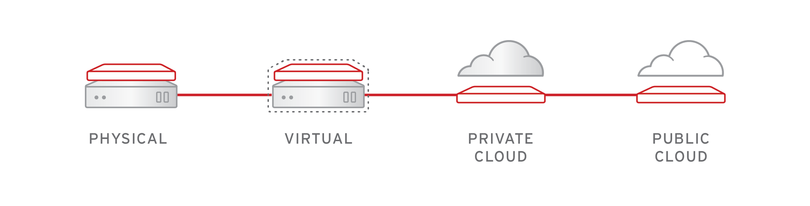
Full-stack automated install
OPENSHIFT 3 & 4
OPENSHIFT 4 (only)
OPENSHIFT PLATFORM
OPENSHIFT PLATFORM
OPERATING SYSTEM
OPERATING SYSTEM
INFRASTRUCTURE
Notes:
This diagram shows how we are bringing full stack install automation on immutable infrastructure to OpenShift 4
On the left, you see how OpenShift 3 installer works. To install OpenShift 3, a user must first configure the underlying infrastructure provider, then deploy RHEL installs, then they can install OpenShift on top of that. From there, OpenShift and RHEL are upgraded and managed separately but must remain in synch.
On the right, you see how OpenShift 4 installer works. The OpenShift 4 includes RHEL CoreOS as a component of the product. OpenShift 4 install will first configure the underlying provider, then spin up RHEL CoreOS Nodes, then deploy your Kubernetes cluster and cluster services on it.
You go from configuring and managing 3 separate entities, to one full stack automated installation process.

Slide 14
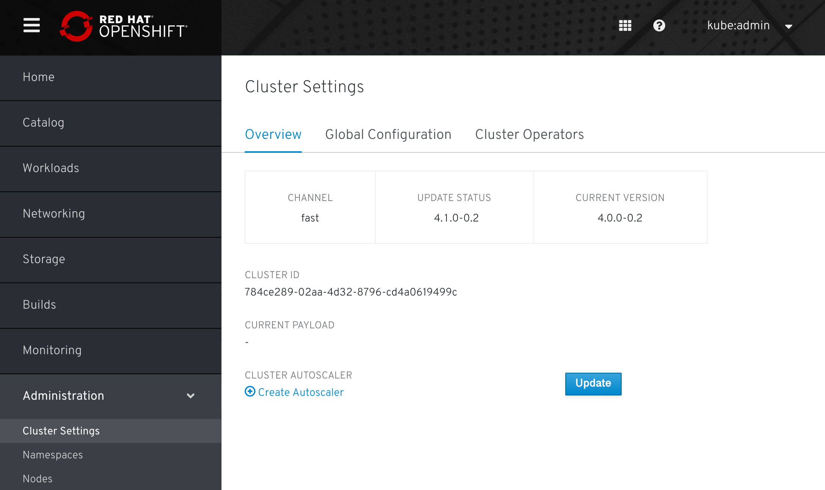
Seamless Updates
OpenShift retrieves the list of available updates
Admin selects the target version
OpenShift is updated over the air
Auto-update support
Notes:
Customers aren’t just struggling to install OpenShift, they also struggle with upgrades and staying up to date with the latest patch and feature releases
Our goal is not just to simplify OpenShift installation, but to make upgrades seamless through a new fully automated, over the air update model.
We want to make upgrading the OpenShift platform as easy as updating your mobile phone platform

Slide 15



Comprehensive container security
Container content
CI/CD pipeline
CONTROL Application security
Container registry
Deployment policies
Container platform
Container host multi-tenancy
DEFEND Infrastructure
Network isolation
Storage
Audit & logging
API management
EXTEND
Security ecosystem
Notes:
Static security policies & checklists no longer suffice and don’t scale for containers in the enterprise. To truly get the business advantages of containers, enterprises need to evolve their approach to security. Security must become a continuous activity. And must be considered at every stage of your application and infrastructure lifecycle. Doing this right, with planning up front, can lead to better, more integrated security solutions and faster app delivery
Securing containers is a lot like securing any running process. You need to think about security throughout the layers of the solution stack before you deploy and run your container. You also need to think about security throughout the application and container life cycle. We’re going to look at securing containers in the 3 major categories of an enterprise container solution: You need to control the security of your containerized apps, defend your container platform infrastructure and extend the security of your overall solution by leveraging tools from the broader security ecosystem.

Slide 16

“”
We can localize clusters in different markets if we need to and therefore serve our customers on a worldwide scale.
Dr. Alexander Lenk
Lead Architect Connected Vehicle, Digital Backend, Big Data, Blockchain
BMW Group
BMW
Connected Drive
Notes:
https://youtu.be/FUu4kMc0PL8?t=5325
In the automobile industry, Tesla, Uber and Lyft are now competing with traditional car companies. And to differentiate, digital services are becoming more and more important.
BMW’s Connected Drive enhances the “ultimate driving machine” with a digital service experience that enhances the driver experience. It lets drivers find and navigate to a restaurant, and then use a concierge service to make a dinner reservation.
With the connected drive mobile app, you can remotely start your car and heat it up when it’s cold outside.
The connected drive backend runs entirely on OpenShift and processes over 1 billion requests a week.
And BMW uses AIML and data analytics to personalize these services and to create new experiences
---
More detail from Alexander Lenk, BMW chief architect:
Digital services become more and more important
Map updates over the air, concierge call, make a reservation at a restaurant
Use a cell phone to open the car, heat it up when it’s cold outside.
Every year (2.5m cars sold - IOT devices - onto their backend).
Add new services to existing fleet.
30% growth of request rate of backend services. Microservices on shared infrastructure. 1B requests per week
A few years back started journey with Openshift in 2016. Backend completely migrated to openshift.
12,000 containers today
Public cloud to resilience and scale, serve local markets
AIML data for best personalized experience to tailor service to their customer.
Building datalake in the public cloud (AI platform).
Creating a new customer experience, building new services.

Slide 17
A cloud-like experience, everywhere
Operator Framework
Operator Hub & ISV ecosystem
Multicluster management
Notes:
Let’s talk about how OpenShift 4 enables a cloud-like experience everywhere by automating day 2 management.

Slide 18








A consistent container application platform
FROM YOUR DATACENTER TO THE CLOUD
Automated operations
Multi-tenant
Secure by default
Network
traffic control
Over-the-air updates
Monitoring & chargeback
Pluggable architecture
Bare metal, VMware vSphere, Red Hat Virtualization, Red Hat OpenStack Platform, Amazon Web Services, Microsoft Azure, Google
Notes:
No matter what infrastructure you have chosen, OpenShift provides the necessary tooling and process automation to enable teams to operation Kubernetes efficiently and economically

Slide 19
Kubernetes adoption phases
1. Stateless apps
2. Stateful apps
3. Distributed systems
ReplicaSets
Deployments
StatefulSets
Storage/CSI
Data rebalancing
Autoscaling
Seamless upgrades
Notes:
This Operator community was birthed from the progression of app workloads on Kubernetes: we’re now running complex distributed systems that require concepts above the built-in Objects like StatefulSets and Deployments. Things like data rebalancing and doing seamless upgrades of those complex apps.

Slide 20
Automated container operations
FULLY AUTOMATED DAY-1 AND DAY-2 OPERATIONS
INSTALL
DEPLOY
HARDEN
OPERATE
AUTOMATED OPERATIONS
Infra provisioning
Full-stack deployment
Secure defaults
Multicluster aware
Embedded OS
On-premises and cloud
Network isolation
Monitoring and alerts
Unified experience
Audit and logs
Full-stack patch & upgrade
Signing and policies
Zero-downtime upgrades
Vulnerability scanning
Notes:
OpenShift automated installation provides a simple, reliable, opinionated and immutable installation process for OpenShift taking advantage of the technologies acquired from CoreOS on top of the Red Hat CoreOS operating system which is designed and optimized for running containers. The self-hosted process makes upgrading OpenShift clusters in production a risk-free and repeatable task and as simple as updating an application on your iPhone! OpenShift also gives a choice to the IT Ops if they prefer a customizable and mutable installation method on top of traditional RHEL, which allows them to install and manage OpenShift clusters in whatever way that the organization has sanctioned.
===
*coming soon: some automated operations are based on implementing operators throughout the platform. This will begin shipping in Sept/Oct 2018 with the OCP 3.11 release, and with full integration and automated operations with OCP 4.0 (targeted for GA Dec 2018)

Slide 21





Kubernetes-native day 2 management
Flexible app architectures
No reinvention
of core concepts
Uniform deploy
and debug
Truly hybrid
Operators codify operational knowledge and workflows to automate life-cycle management of containerized applications with Kubernetes
Notes:
Because you’re translating best practices into Kubernetes concepts, you’re not reinventing the wheel and you end up with a truly hybrid application. Operators function the same no matter where they are running.
The Operator Framework is a set of tools that helps you build and run Operators on a Kubernetes cluster, including an SDK to get you up and running quickly.

Slide 22
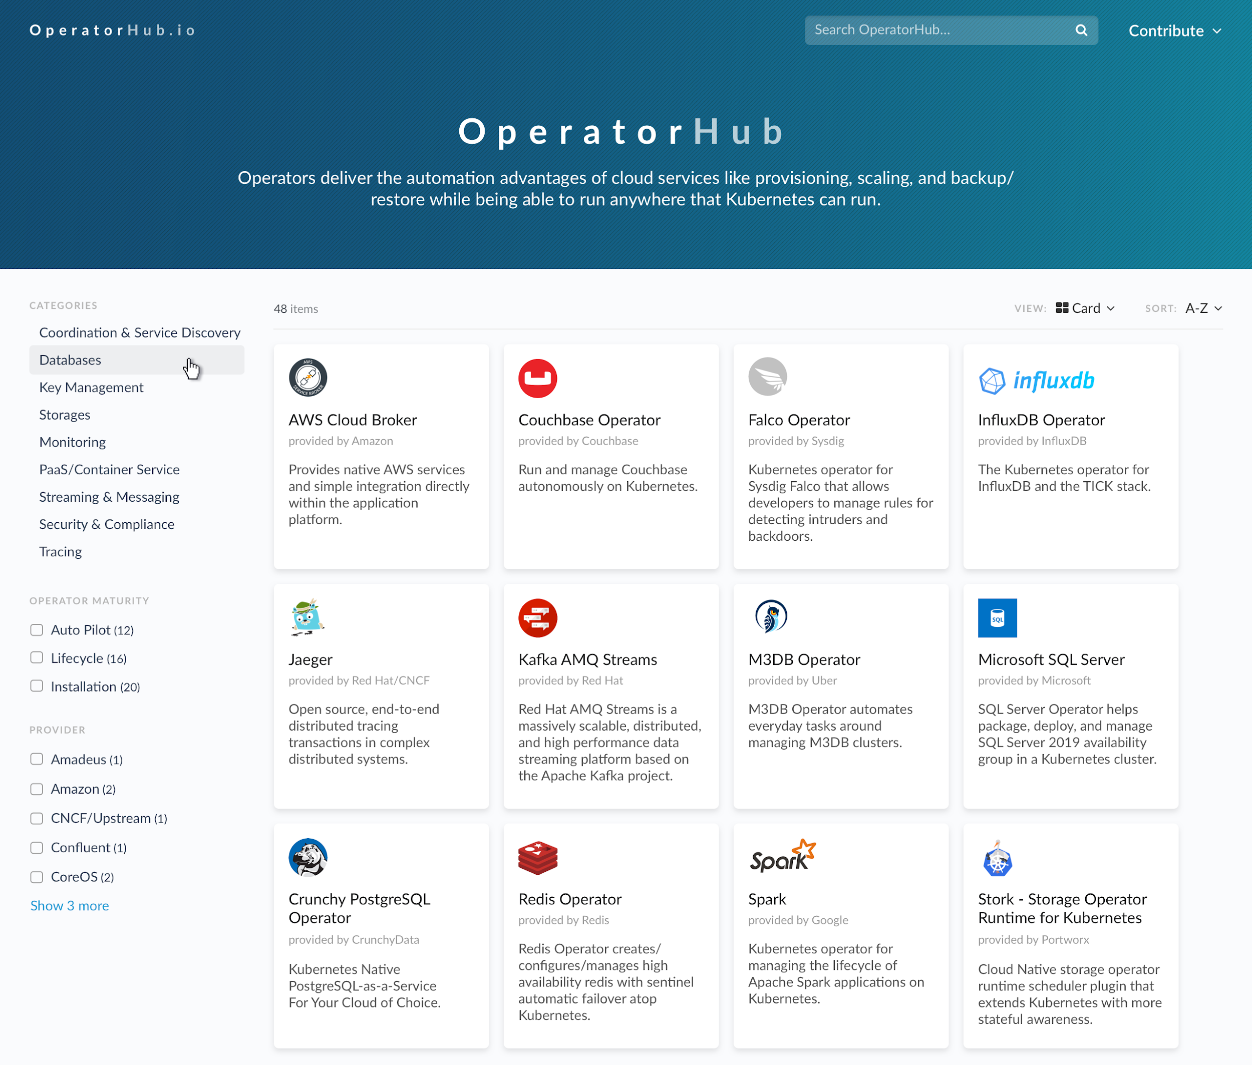
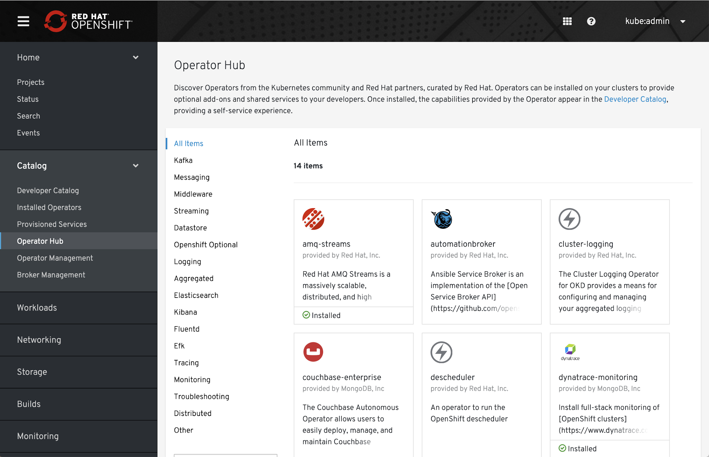
OperatorHub and certified Operators
OperatorHub.io launched by Red Hat, AWS, Microsoft and Google
OpenShift Operator Certification
OperatorHub integrated into OpenShift 4
COMMUNITY OPERATORS
OPENSHIFT CERTIFIED OPERATORS
Notes:
So how do you get these operators?
The Operator Hub was launched by Red Hat and our launch partners AWS, Microsoft and Google earlier this year. It provides a single place on the internet for developers to publish operators and for customers to find and consume curated operators.
These operators meet certain quality standards so you can have the confidence they deliver what they promise. You can deploy these operators on any Kubernetes distribution, not just OpenShift.
But we’ve also integrated the OperatorHub into OpenShift where you can also find fully certified operators from our partners that meet a very high bar of quality standards.

Slide 23
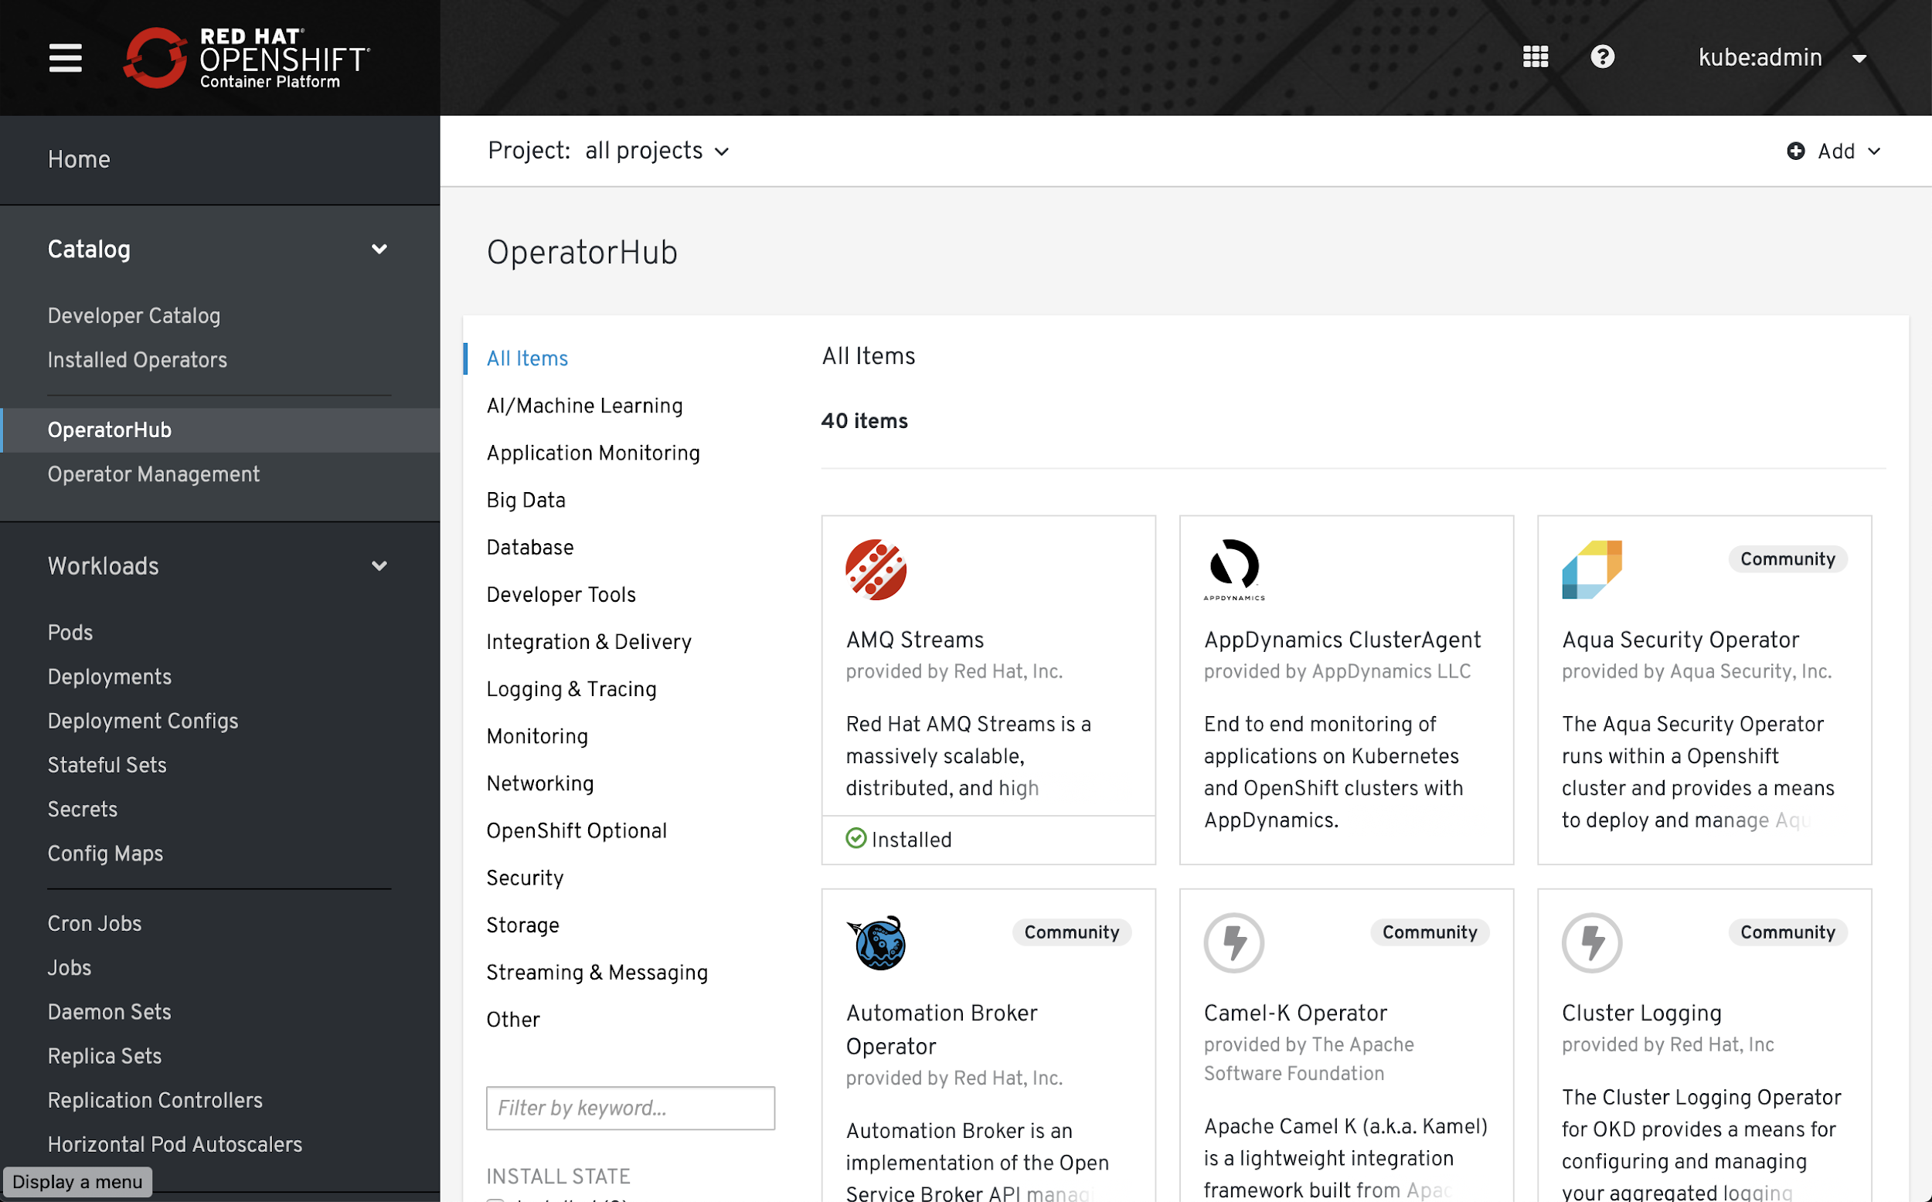
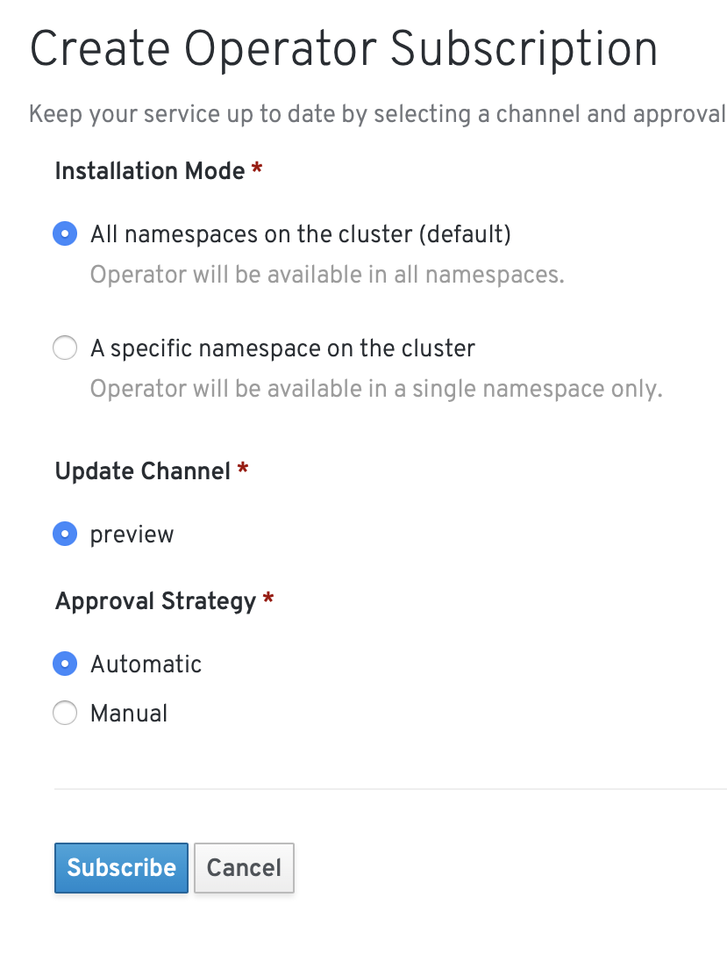
Full control for administrators
Notes:
Inside of OpenShift, admins have full control over which Operators are installed across the cluster and gain tools for upgrading them from a central point.

Slide 24
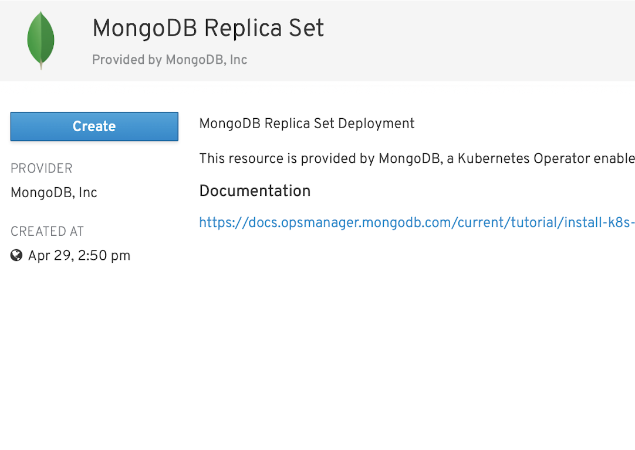
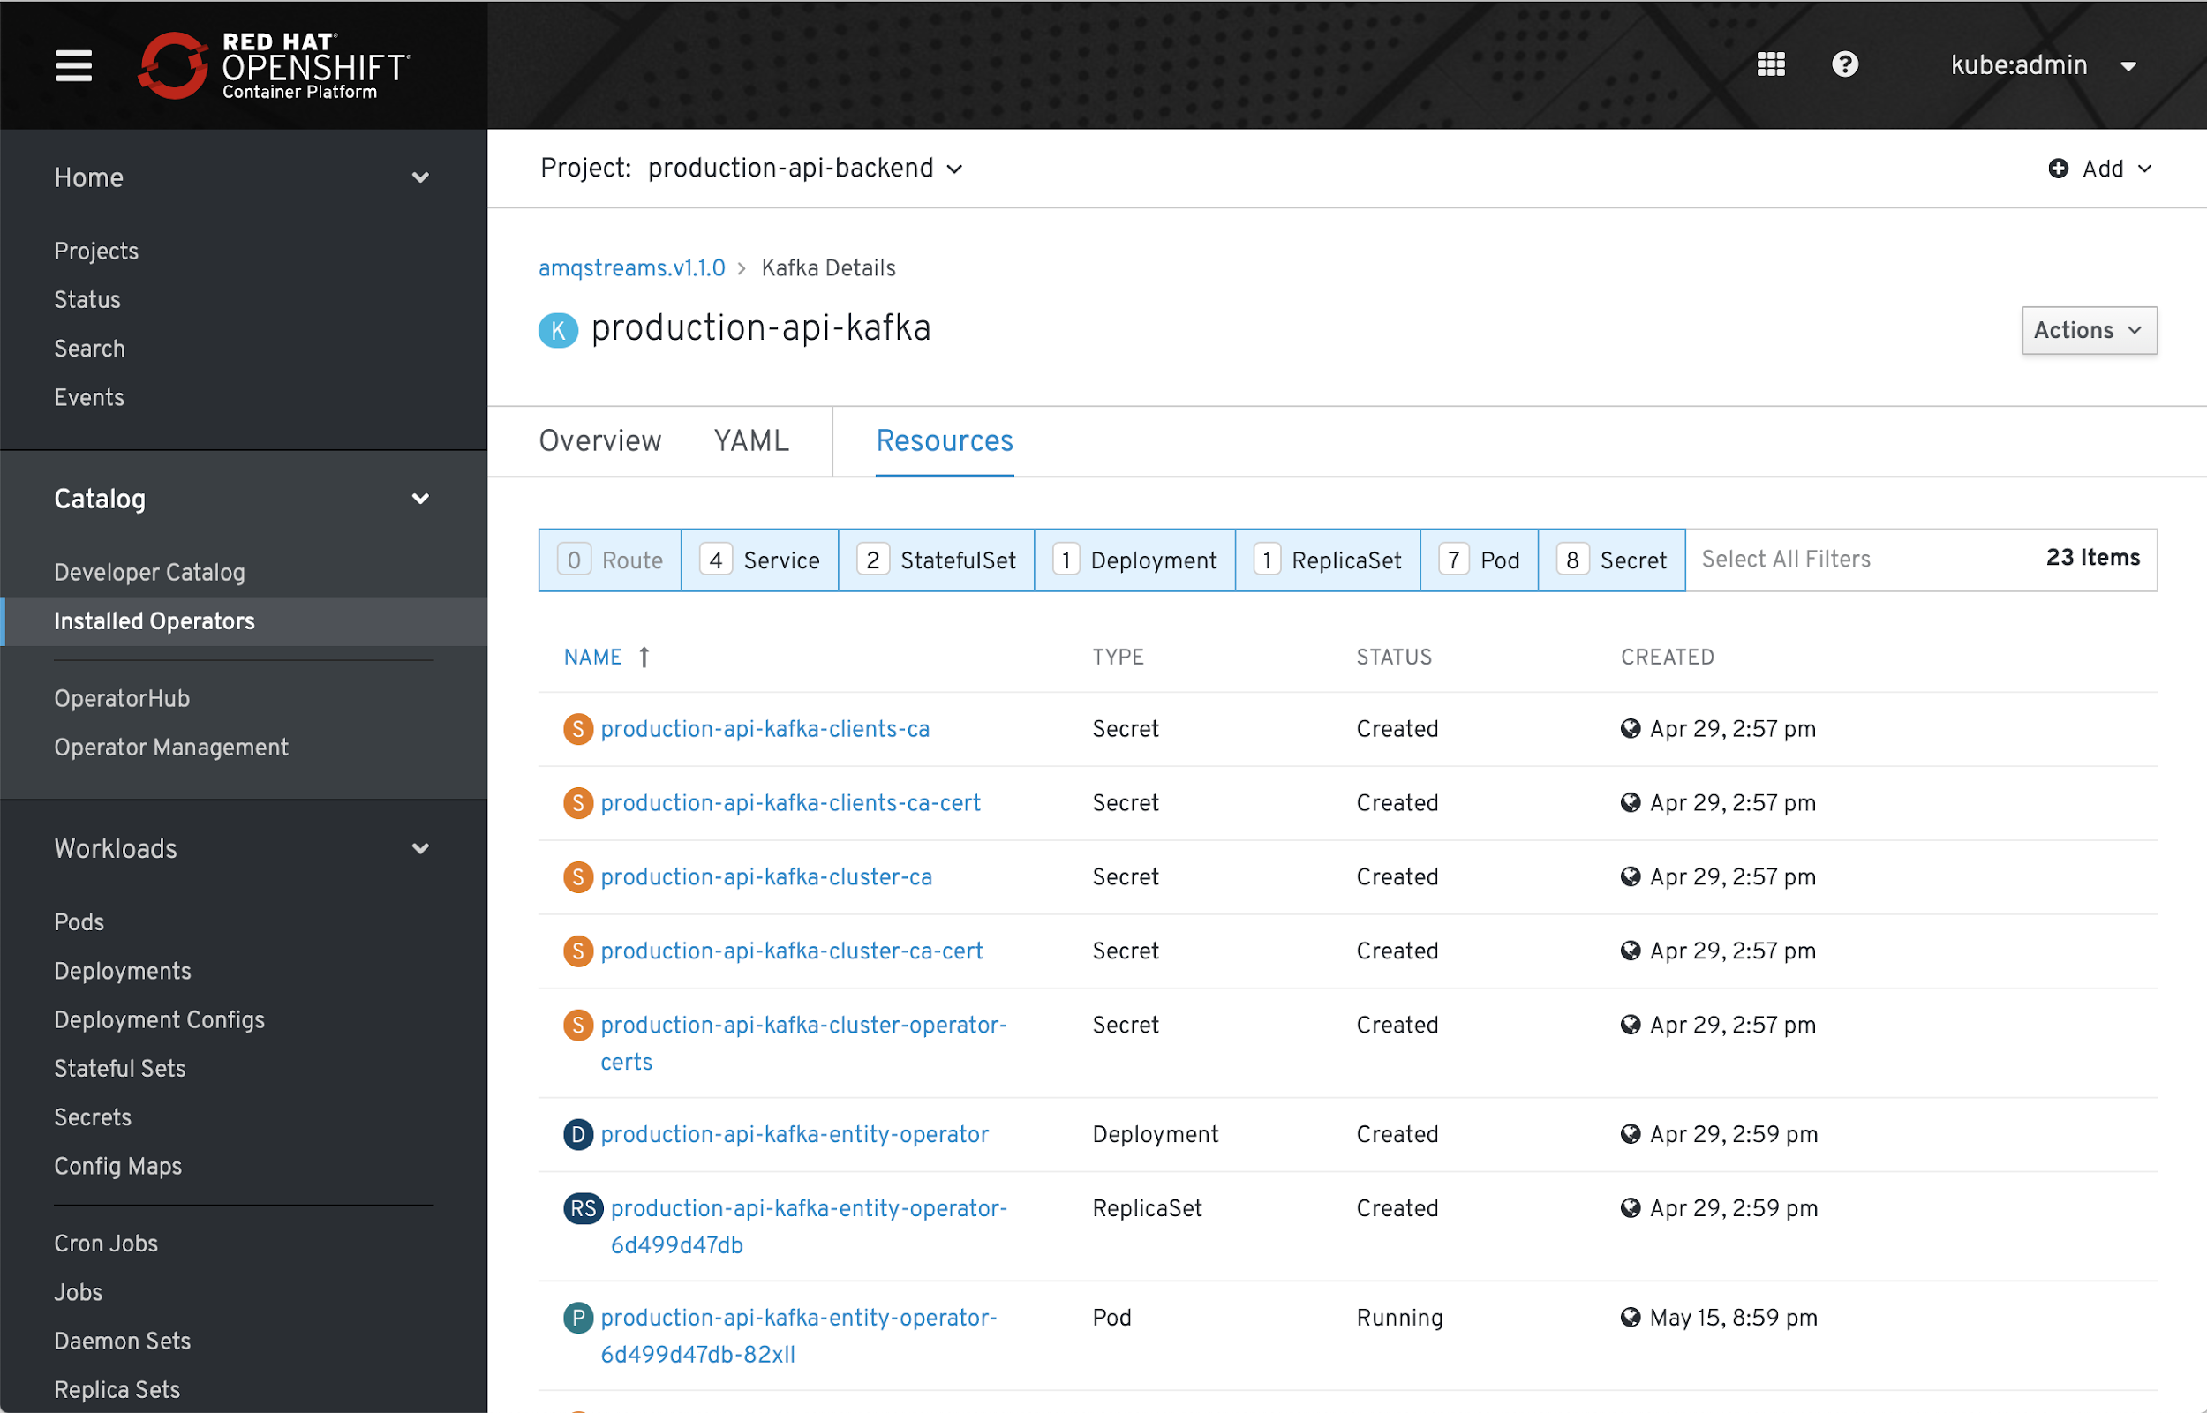
Self-service for developers
apiVersion: mongodb.com/v1
kind: MongoDbReplicaSet
metadata:
name: example
namespace: production
spec:
members: 3
version: 4.0.2
persistent: false
project: example
credentials: my-secret
Notes:
Engineers interact with Operators in a self-service manner, just like any other Kubernetes object.
Here you can see a developer’s view of all Operator capabilities exposed to them, with self service access to manage them.

Slide 25

“”
Using the Prometheus Operator, our dev teams are able to provision their own end-to-end monitoring. We could not hope to manage the 344 Prometheus instances without the domain knowledge the Operator encapsulates.
Michael Goodness
Lead Systems Engineer
Ticketmaster
Notes:
The value of operators is tremendous.
Here is Ticketmaster talking about the fact that they can now deploy Prometheus at scale in a more self-service and self-managing manner.

Slide 26
Why OpenShift for hybrid and multi-cloud deployments?
IDC Research: The Business Value of OpenShift on AWS
Our developers say that OpenShift on AWS is very easy to use, and they are definitely more productive as a result ... seeing 60-70 percent increases in productivity levels.
We have a multi-cloud environment and OpenShift on AWS has features that make it easier to be agile.
OpenShift on AWS has really helped us improve our reservation system and contributed to up to 15 percent more revenue, worth tens of millions of dollars per year.
“”
“”
“”
Financial Services
Pharmaceutical
Hospitality
Source: IDC Report “The Business Value of an Agile and Flexible Platform for Developing and Running Applications with OpenShift on AWS”, May 2019
Notes:
A recent IDC report specifically addressed the value of running OpenShift on AWS. The results of that report showed that customers were able to see significant improvements to process and resulting revenues by running OpenShift on AWS cloud infrastructure.

Slide 27
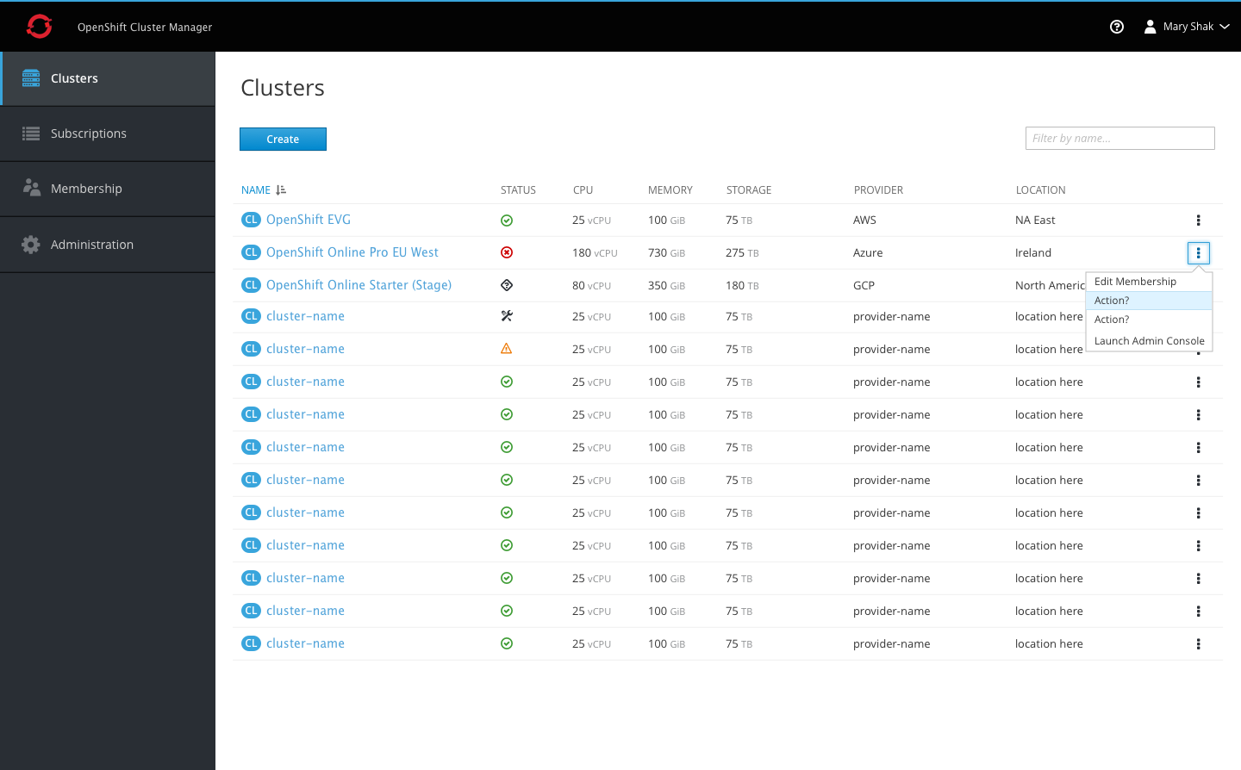
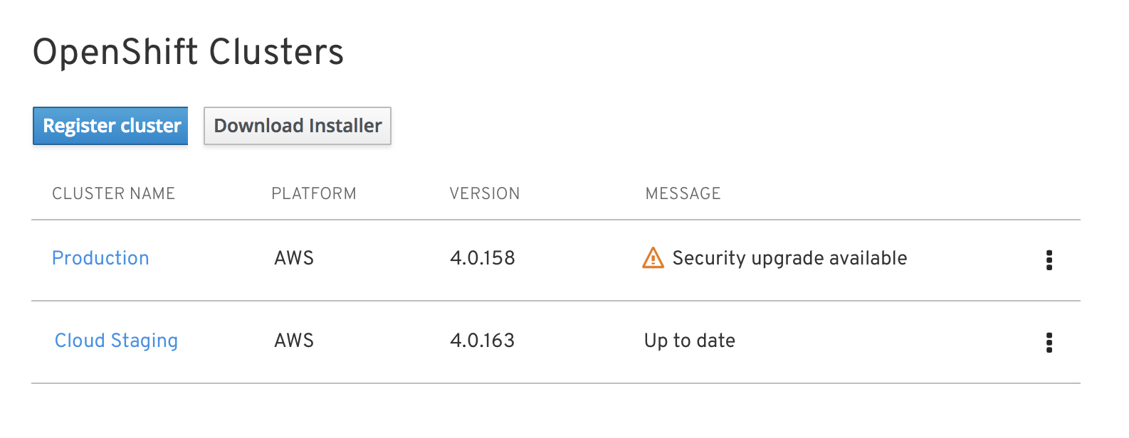

Delivering Kubernetes everywhere
Manage multiple OpenShift clusters, across multiple cloud and on-premises environments
Install and update OpenShift across all your cloud environments
Centrally manage policy and deployments
cloud.redhat.com
Notes:
To help you manage many different OpenShift clusters we’re now also offering a SaaS-based management console that allows you to register existing OpenShift clusters and provision new ones so you can get comprehensive visibility across all your clusters
Simply log on to cloud.redhat.com and you’re good to go.

Slide 28

“”
Red Hat OpenShift Container Platform lets us move applications seamlessly and easily across multiple providers with no downtime. We can also use public cloud to scale up or down as demand requires.
Kerry Peirse
General Manager, IT Infrastructure and Operations
Cathay Pacific Airways Limited
CATHAY PACIFIC
Taking customer experience to new heights
Notes:
In the airline industry, Cathay Pacific is a familiar name to many air travellers
Cathay operates in a region with the biggest growth in the industry but who also needs to be very mindful of the impact on the environment
Cathay’s mission is to become the world’s best airline with a strategy to improve flight operations, to make flights more fuel efficient, and to improve customer interactions.
Cathay Pacific has modernized their legacy infrastructure with OpenShift running in a hybrid cloud environment based on OpenStack and AWS.
OpenShift supports all business to consumer applications which allows them to deliver value to customers faster.
Cathay can deploy new services in 30-60 minutes and the infrastructure required in only 5 seconds, for example to run marketing promotions based on seat availability.
In last year (2018), Cathay Pacific won the award in the best airline category, best entertainment, and best economy class

Slide 29
Empowering developers to innovate
Service mesh
Serverless
Red Hat CodeReady Workspaces & developer tooling
Notes:
Last but not least, we should also talk about how OpenShift 4 enables developers to innovate and build next-generation applications in new ways.

Slide 30
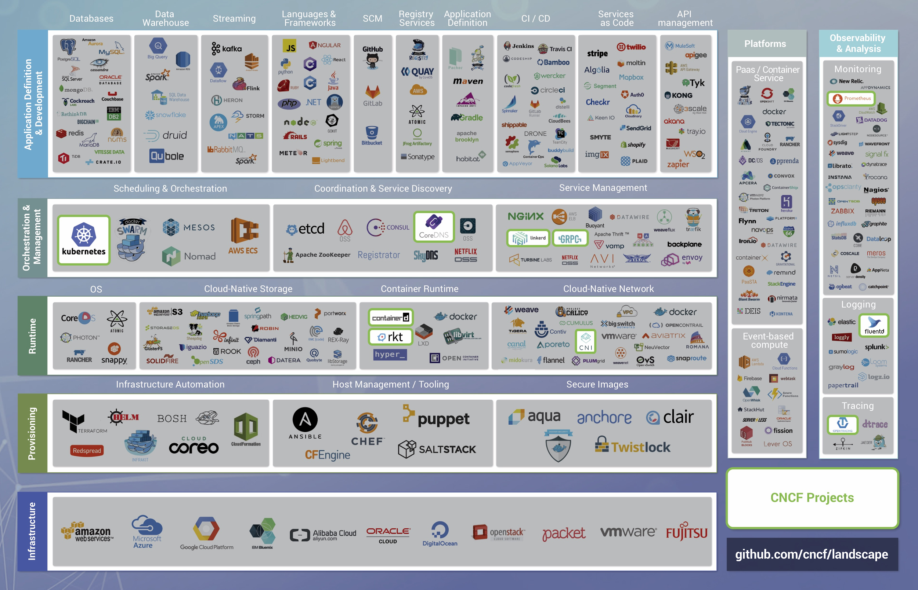
Notes:
THIS IS A MAP OF ALL THE CLOUD-NATIVE COMPONENTS YOU NEED TO CHOOSE FROM IN ORDER TO RUN CONTAINERS IN PRODUCTION. It’s compiled by the Cloud Native Computing Foundation, the same open source governing body that is home to Kubernetes (which was its first project). It covers everything from infrastructure through application / developer services, as well as observability tools for the whole stack. It gets bigger and more complicated every few weeks, when a new revision rolls out. (Side note: this does not include serverless frameworks - that’s an entirely separate map)
Latest version of this map is always here: https://github.com/cncf/landscape

Slide 31
THE CLOUD-NATIVE APP DEV CHALLENGE
Notes:
Anyone building their own container platform will have to vet, test, and select individual technologies throughout the stack, keep up with each component individually throughout its lifecycle, and make sure that they all work together. Red Hat OpenShift does this work for you - we test and support the whole stack, including validated integrations for networking, storage, metrics, logging / monitoring, ingress, authentication / authorization, languages, frameworks, middleware, and databases.

Slide 32





OpenShift enables developer productivity
BUILD
TEST
DEPLOY
Self-service provisioning
Consistent
environments
Automated
build & deploy
CI/CD pipelines
Configuration management
App logs & metrics
CODE
REVIEW
MONITOR
SPRING & JAVA™ EE
MICROSERVICES
FUNCTIONS
LANGUAGES
DATABASES
APPLICATION SERVICES
LINUX
WINDOWS*
* coming soon
Notes:
No matter what architecture you choose for your applications, what programming language the developers find most useful and what services you want to use as building blocks, OpenShift provides a single and consistent development model across the build, test, deploy, monitor, and review lifecycle of the application.
Self-service infrastructure: let’s developers provision what they need on-demand and skip waiting for hours, days and sometimes weeks for infrastructure resources
Consistent environments: OpenShift makes sure the environment provisioned for developers and across the lifecycle of the application is consistent from the operating system, to libraries, runtime version (e.g. Java runtime) and even the application runtime in use (e.g. tomcat) in order to remove the risks originated from inconsistent environments
Automated build and deployment: OpenShift gives a choice to developers, to build their containerized applications themselves or to have the platform build containers from the application source code or even binaries. The platform then automated deployment of these applications across the infrastructure based on the characteristic that the team has defined for the apps such as how much resources should get allocated and where on the infrastructure they should get deployed to be compliant with third-party licenses.
Continuous delivery pipelines: OpenShift provides out-of-the-box support for CI/CD pipelines so that development teams can automated every step of the application delivery process and make sure it’s executed on every change that is made to the code or configuration of the application
Configuration management: configuration and sensitive data management is built-in in the platform to ensure consistent and environment agnostic application configuration is provided to the application no matter what technologies is used to build the application and which environment it is deployed. Application logs & metrics: rapid feedback is an important aspect of application development. OpenShift integrated monitoring and log management provides immediate metrics back to developers in order for them to study how the application is behaving across changes and be able to fix issues as early as possible in the application lifecycle.

Slide 33






Building next-gen applications
OpenShift Service Mesh
Integrated Service Mesh for enhanced security and network segmentation of microservices applications. Combines Istio, Kiali (UI), and Jaeger (Tracing) projects.
OpenShift Serverless
Integrated serverless, enabling scale-to-zero FaaS services and event sources - built on the Knative framework.
Support for Azure Functions
Integrated with Camel-k for rich set of initial event sources: HTTP, Kafka, AMQP
OPENSHIFT
SERVERLESS
OPENSHIFT
SERVICE MESH
Notes:
As we discussed before, OpenShift supports a very broad range of application types and frameworks.
Service Mesh and Serverless are exciting technologies that make it easier to build and run microservices architectures and we support both in OpenShift 4.
Service Mesh provides networking capabilities at the application layer so that application components can discover services and communicate with one another. OpenShift also supports monitoring and tracing of inter-application network traffic using Kiali, Jaeger and Istio framework underneath.
Serverless is less mature at this stage and we have announced support for a number of event sources on the knative framework including Azure Functions, OpenWhisk and Camel K.

Slide 34

Enabling greater developer productivity
CodeReady Workspaces
Web-Based IDE (Eclipse Che), Collaborative Development, integrated with CI/CD.
OpenShift ODO
Advanced developer CLI
OpenShift Plugins
Integration plugins - VScode, Azure DevOps, Eclipse IDE, JetBrains
CODEREADY
WORKSPACES
ODO
DEV
VSCODE
AZURE DEVOPS
ECLIPSE
JETBRAINS
Notes:
In terms of developer tools, CodeReady Workspaces provides an Eclipse Che-based developer IDE that is tightly integrated with OpenShift. CodeReady Workspaces provides support for development teams to build applications together.
But even if you’re using Visual Studio Code, Intelli-J or any other IDE, OpenShift plug ins allow you to use your existing tools yet deploy your apps on OpenShift.
And for command line users, odo gives you a very powerful CLI to deploy applications on the command line.

Slide 35



CodeReady Workspaces
The collaborative OpenShift-Native IDE. Free for any customer of OpenShift Dedicated or OpenShift Container Platform.
Container Workspaces
Workspace replicas to end “works on my machine” and enable team collaboration.
DevOps Integrations
Reference developer workspaces from any issue, failed build, or git notification.
Protect Source Code
Full access to source code without any of it landing on hard-to-secure laptops.
Based on the open Eclipse Che project
Red Hat Linux and Application Infrastructure
Plugin model for extensibility
Serverless support
(coming soon)
Use It To: Replace VDI for devs, and enable true container-based DevOps.
Notes:
There are some key advantages to using CodeReady workspaces with OpenShift.
ACCELERATE
ONBOARDING
Pre-configured and shareable dev workspaces with all tools pre-installed
CONSISTENT
WORKSPACES
Identical workspaces to remove “works on my machine” syndrome
PROTECT SOURCE CODE
No code on the hard-to-secure developer and personal laptops

Slide 36
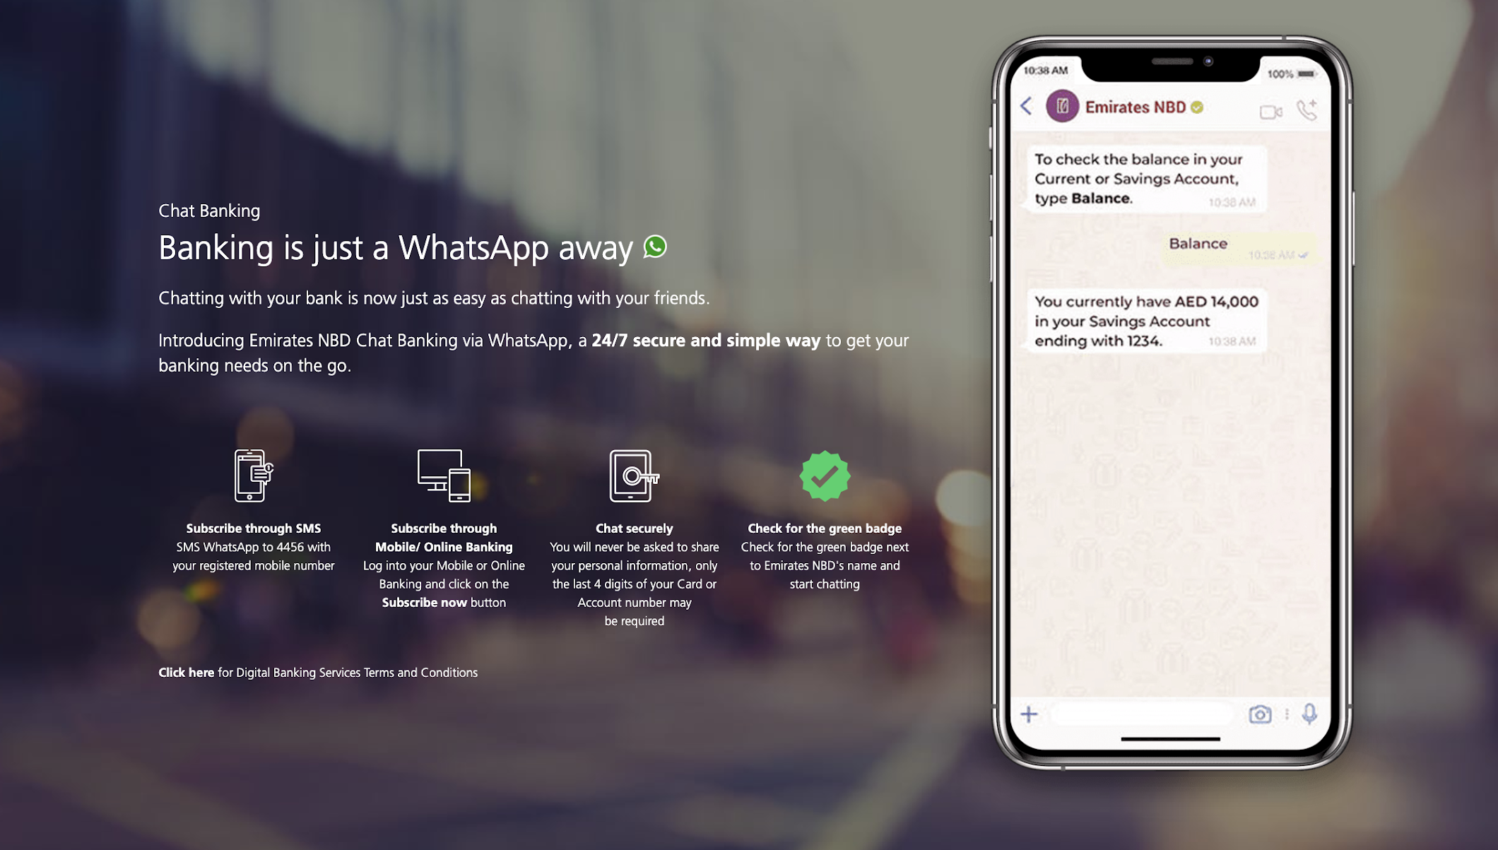
EMIRATES NBD
Notes:
Source: https://www.emiratesnbd.com/en/personal-banking/ways-of-banking/mobile-banking/whatsapp-banking/
https://youtu.be/FUu4kMc0PL8?t=5075
In Banking and Financial Services
Emirates NBD is undergoing a 4 year digital transformation project and trying to change the culture of the bank.
By moving their banking infrastructure onto a private cloud built with OpenShift, Emirates NBD can now change and innovate at speed, and deliver new services in days, not months or years.
For example, the Whatsapp digital banking app was built with plug and play APIs and deployed on their private cloud in only 3 days.
Going forward, Emirates NBD is pushing innovation boundaries such as realtime banking built on Kafka and more personalized services.

Slide 37
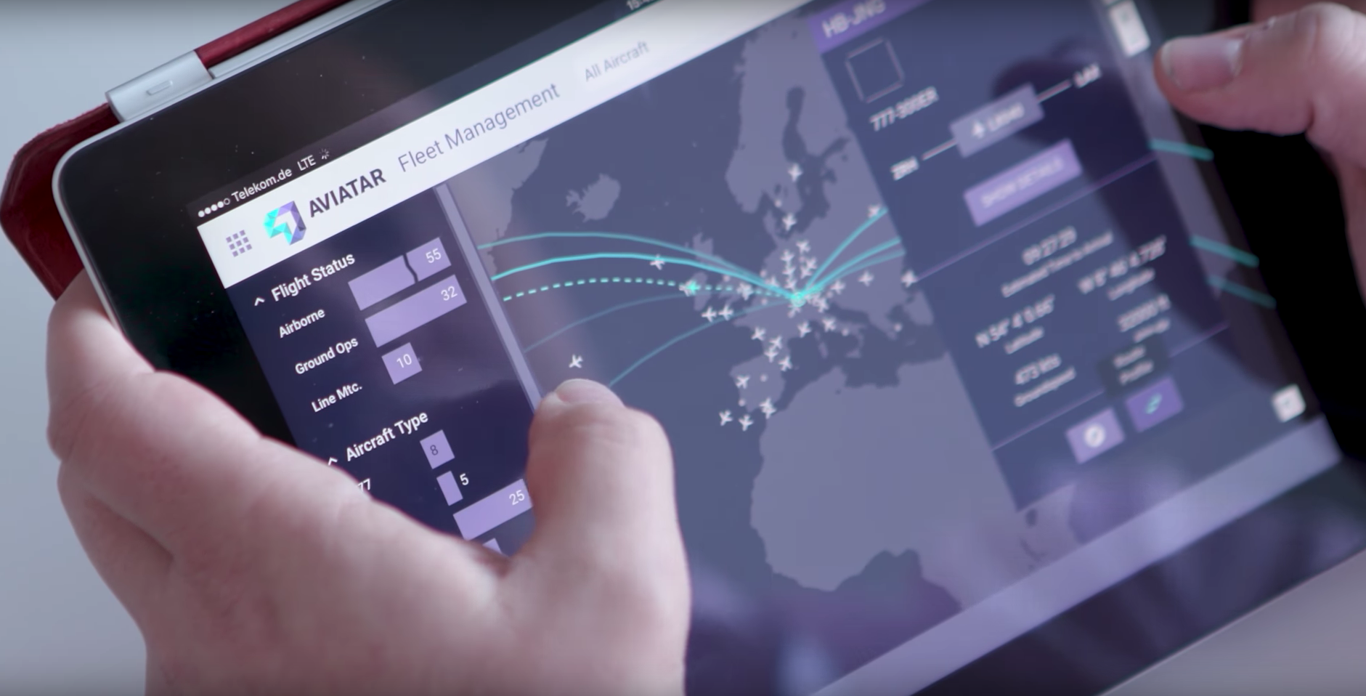

The Kubernetes platform for your business
“The moment we have an idea, we can start building the product.”
Tobias Mohr, Head of Technology and Infrastructure, Lufthansa Technik
Source: Red Hat success story page, Lufthansa Technik builds a digital foundation with Red Hat, May 2018.
Notes:
Our customers are doing amazing, innovative things.
Lufthansa Technik is building entirely new, real-time, data-stream businesses from scratch. Using Red Hat OpenShift, Lufthansa Technik developed an entirely new product and business line to make airline operations safer and more reliable. AVIATAR customers can track their airline fleet and operations in real-time, and receive estimates for task and milestone completions. It’s a hybrid cloud (Azure + private datacenter) solution, built and delivered with containers and Kubernetes through Red Hat OpenShift.
Source: https://www.redhat.com/en/success-stories/lufthansa-technik
Alternate customer references: Vorwork, Smartbow, iSmart [Kathryn to make these slides when the deck is closer to finished, for field to swap in/out]

Slide 38
Red Hat Openshift business value
531%
5-year ROI
66%
36%
8 MONTHS
US$1.29M
Faster development life cycle
More applications per year
Payback period
Average annual benefits per 100 developers
The Business Value of Red Hat OpenShift, IDC #US41845816, October 2017, https://www.redhat.com/en/resources/The-Business-Value-of-Red-Hat-OpenShift.
Notes:
The customer results have been documented and quantified. The business value of OpenShift is real to our customers. These metrics are how our customers are describing their outcomes to IDC and are available for you to review as you make your decision on how to move your organization forward.

Slide 39



10x
Increased application development throughput from 20 to 200 changes a day
Months → Days
Improved time to market
by accelerating development time
50%
Reduction in development time for new services and APIs. Launched a new cloud platform in 10 days
OpenShift on AWS & private cloud
OpenShift on AWS
OpenShift on AWS, Azure, & private cloud
Source:
Cathay Pacific: Red Hat press release, Cathay Pacific Takes Customer Experiences to New Heights with Red Hat’s Hybrid Cloud Technologies, May 2018.
Hilton: Red Hat case study, Hilton enhances digital guest experience with Red Hat container and automation technology, October 2018.
Schiphol: Red Hat case study, Amsterdam Airport Schiphol builds agile cloud with Red Hat, August 2017.
Notes:
But there are many more benefits:
Cathay Pacific has truly become a digitally advanced organization pushing hundreds of production updates every day.
Hilton Hotels is delivering new capabilities and features with their OpenShift platform running on AWS in days instead of months.
And Amsterdam Schiphol airport has implemented a multi-cloud platform spanning their own datacenter, AWS and Azure that resulted in a 50% reduction in development time for their APIs and services.

Slide 40
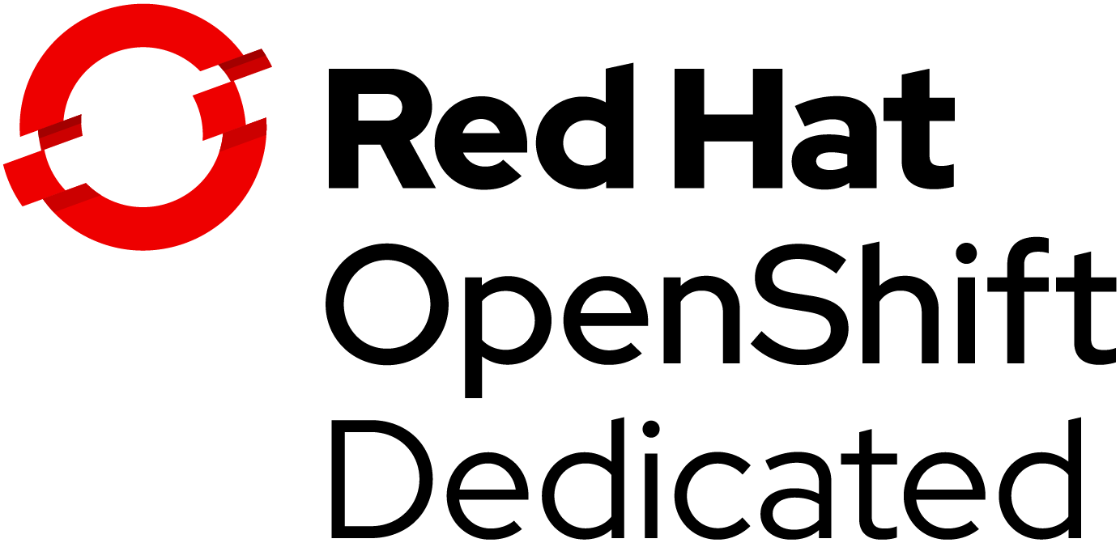
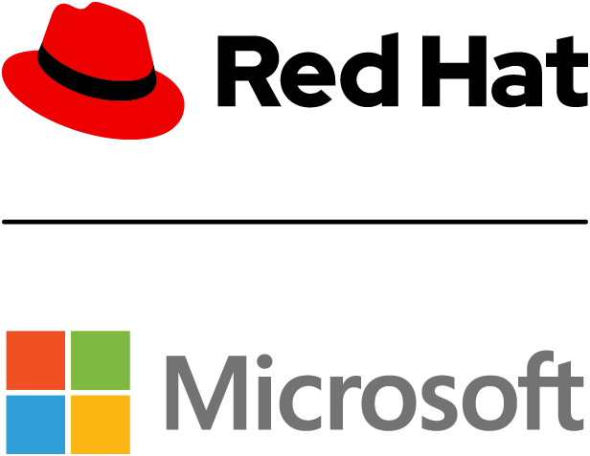
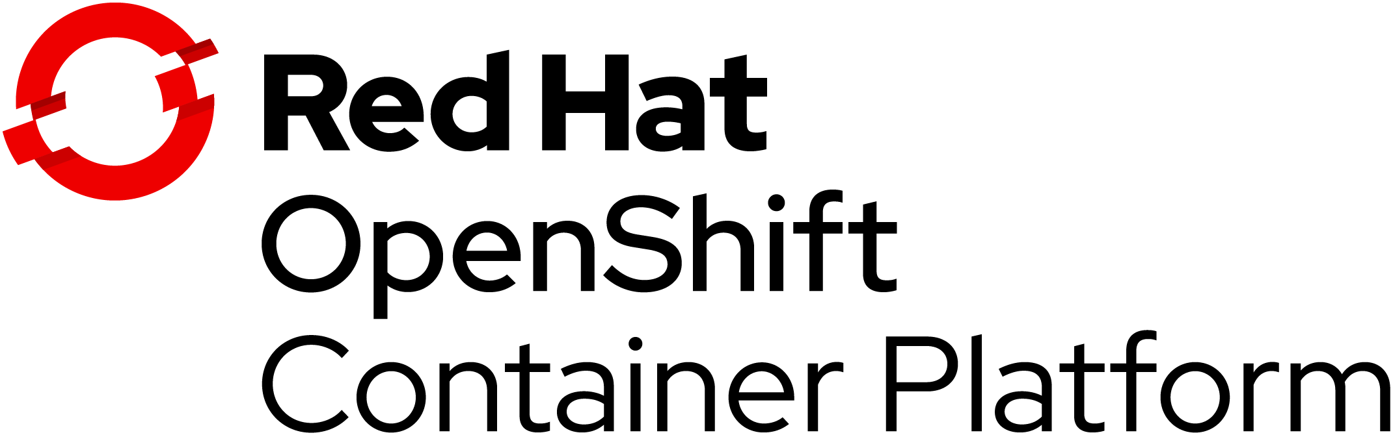
One platform, flexible consumption models
Azure
Red Hat OpenShift
Managed service offering on your choice of AWS, Azure, or Google
Joint engineering, operation, and integrated support by Microsoft and Red Hat
Enterprise-grade Kubernetes platform that you manage
HOSTED SERVICES
SELF-MANAGED
Notes:
OpenShift is a single product with 3 consumption models to give a choice to customers in order to balance the level of productivity and operational efforts versus the level control they need in the platform.
OpenShift Dedicated: a professionally managed, enterprise-grade Kubernetes by Red Hat on one of the public clouds (Amazon Web Services, Google Cloud Platform and Microsoft Azure) and dedicated to a single customer with custom setups for private networks, etc
Azure Red Hat OpenShift: Jointly engineered, operated, and supported by both Microsoft and Red Hat with an integrated support experience
OpenShift Container Platform: secure Kubernetes platform on your own infrastructure. Build, deploy and manage your container-based applications consistently across cloud and on-premise infrastructure.

Slide 41








Red Hat Services for OpenShift adoption
RED HAT OPEN INNOVATION LABS
RED HAT CONTAINER ADOPTION PROGRAM
EXPERIMENT
CATALYZE INNOVATION
FRAMEWORK FOR SUCCESSFUL CONTAINER ADOPTION AND I.T. TRANSFORMATION:
Rapidly build prototypes,
do DevOps, and be agile.
Bring modern application
development back to your team.
Mentoring, training, and side-by-side collaboration to:
Create a production platform and team to run it
Create end-to-end container-driven deployment automation
Scale application onboarding expertise
Guide new Kubernetes-native development
Align business with IT through included Red Hat Open Innovation Labs
IMMERSE YOUR TEAM
Work side by side with experts
in a residency-style engagement.
TO SHOW YOUR TEAMS HOW OPENSHIFT AND MODERN DEVELOPMENT PRACTICES CAN DRIVE INNOVATION: START WITH A 4- TO 12-WEEK LABS RESIDENCY
TO BEGIN A COMPREHENSIVE PROGRAM (INCLUDING OPEN INNOVATION LABS): START WITH THE 12-WEEK RED HAT CONSULTING CONTAINER PLATFORM PILOT
Notes:
For more information about the Red Hat Consulting Container Adoption Program, see the Business Presentation, Technical Presentation, and internal-only Sales Enablement decks.
For details

Slide 42

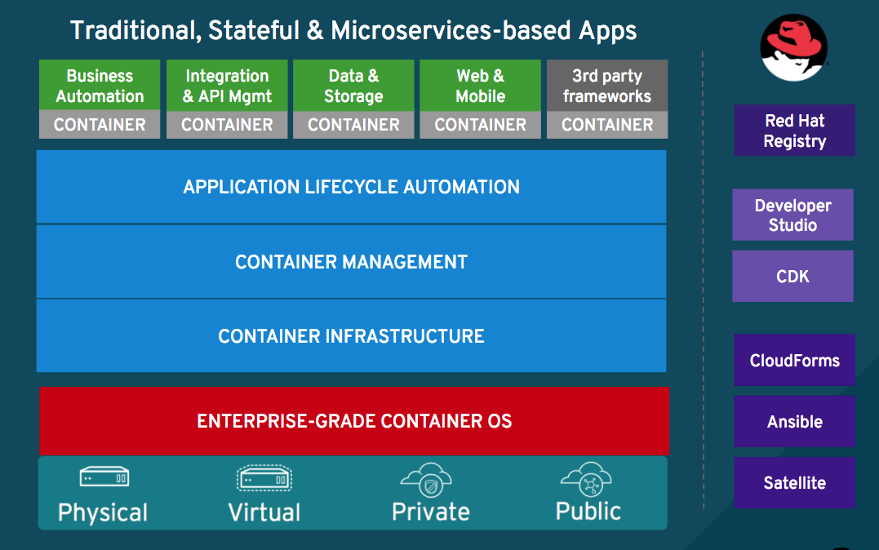




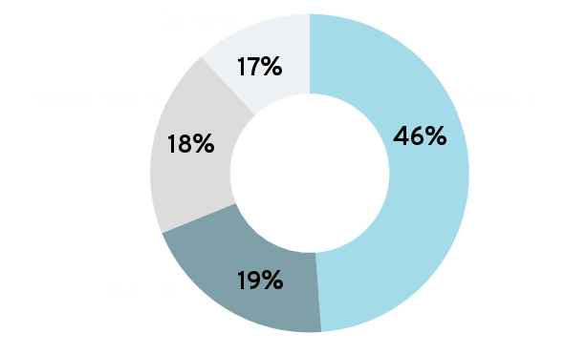



























Why is Red Hat the best choice?
THE 4 C’s
CODE
CUSTOMERS
CLOUD
COMPREHENSIVE
Kubernetes commits
Red Hat is a leading Kubernetes developer & contributor with Google¹.
We make container development easy, reliable, & more secure.
1,000+ customers²
We have years of experience running OpenShift Online & OpenShift Dedicated services.
We have strong partnerships with cloud providers, ISVs, & CCSPs.
We have an extensive container catalog of certified partner images.
Our comprehensive portfolio of container products and services includes developer tools, security, application services, storage, & management.
Source: [1] Stackalytics, Contribution by Companies. (Release: All, Project type: Kubernetes, Module: kubernetes, Metric: Commits)
Retrieved: March 2, 2018. [2] More Than 1,000 Enterprises Across the Globe Adopt Red Hat OpenShift Container Platform to Power Business Applications
Notes:
Code
Red Hat is one of the leading contributors to Kubernetes, next to Google
Red Hat and CoreOS have also provided key features to upstream Kubernetes, including:
Operators, for streamlined packaging, deployment, and management of Kubernetes applications (enabling automated operations)
etcd (through CoreOS), the “brain” of Kubernetes, which provides configuration and service discovery across clusters
StatefulSets, for managing stateful applications - a huge improvement over ephemeral containers
Role-based access control (RBAC), a must-have for enterprise implementations
Customers OpenShift is one of the earliest Kubernetes platforms available in the market, and was released as Kubernetes went GA with v1.0 in June 2015. This means we have more experience supporting customers running Kubernetes than any other vendor. And we run Kubernetes ourselves, with our hosted Online and Dedicated services.
Cloud / Community One of the great benefits of Kubernetes and OpenShift is its ability to deploy and run anywhere. We work closely with partners to ensure that OpenShift runs smoothly in the cloud, including key partnerships with Microsoft Azure (which whom we work to develop Windows capabilities, and to offer a co-managed OpenShift offering) and AWS (with whom we’ve done key work on the Kubernetes Service catalog, and made AWS services available by default from within OpenShift). In addition to cloud providers, we provide certified, secure container images through the Red Hat Container Catalog from dozens of ISV partners.
Comprehensive [Container portfolio]: Our comprehensive portfolio of container products and services includes developer tools, security, application services, storage, & management.

Slide 43

Trusted enterprise Kubernetes
Trusted host, content, platform
Full-stack automated install
Seamless updates & day 2 management
A cloud-like experience, everywhere
Operator Framework
Operator Hub & certified ISVs
Hybrid, multicluster management
Empowering developers to innovate
OpenShift service mesh / Istio
OpenShift serverless / Knative
CodeReady Workspaces / Che
Notes:
Red Hat OpenShift has been designed to address the primary concerns organizations have about adopting containers and Kubernetes. It is a trusted enterprise Kubernetes platform that also helps to address container security concerns. Full-stack automated operations enable OpenShift to help to improve management and consumption of a container platform. And developers can ultimately get applications to production sooner to realize the business results you need.

Slide 44
Thank You

